Slide 1
Evaluation of Kallisto tool and modeling X inactivation with Binomial mixed model
By Vasyl Zhaboynsky

Slide 2
Initial meeting and discussion of the plan
Existence of the X inactivation is not a new phenomenon and based on previous 3*3 cross experiment (analysis detailed in [1]) by investigator we expected to see hundreds of genes per individual mouse having enough allele-specific count estimates, which could be used to estimate mouse level X inactivation as well as cross level inactivation.
This nesting, along with large number of crosses suggested that fitting a mixed model would be a natural choice compared with a linear model with each cross being a separate entry in design matrix.
Processing of such data can take a long time, so the study was planned to be done based on a fast estimation tool Kallisto [2].

Slide 3
Data sources and processing deliberations
After reviewing the difference between previous 3*3 cross and new study we identified and located the other piece of data needed to do the analysis:
Parental haplotypes for each strain.
Once we know these haplotypes we can go to Kallisto tool and annotate which haplotype is maternal and which is paternal (we chose to ignore those, where there is uncertainty in parent haplotype)
Additional question about the data is a review of matching between expected haplotype based on parent data and Kallisto estimate.

Slide 4
Data format
For each sequence data Kallisto produces read count estimates (both in terms of read counts attributed to certain haplotype:
we may have up to 8 possible choices for 8 founder strains, but for each mouse within one gene there should be
no more such expressed haplotypes for female and
no more than one for male mice.

Slide 5
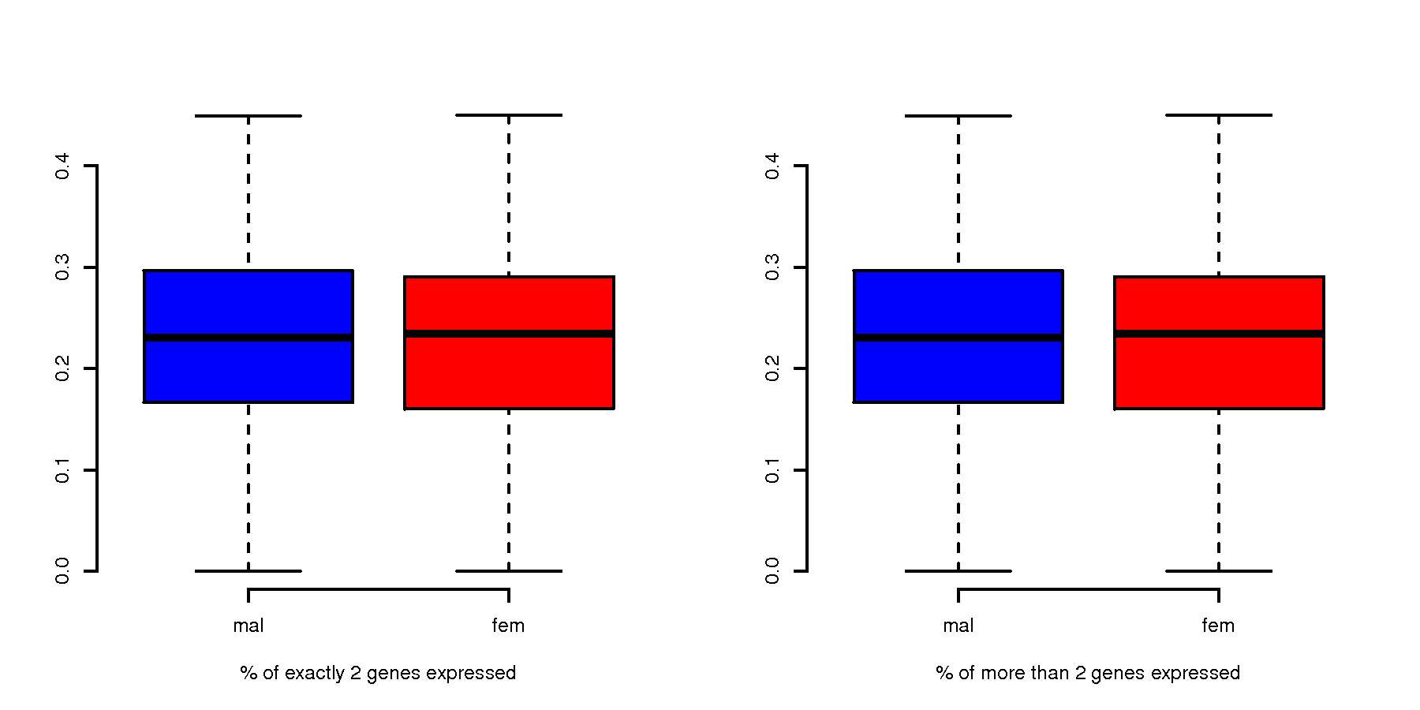
Initial analysis of the data
Our first round is to see whether we observe a big violation of this assumption:

Slide 6
Problems
During pre-processing of the data we found out that some of the samples had contradictory sex information (based on Y chromosome counts from previous mapping). There was not many of such samples, while this issue was set to be resolved due to time constraints we proceeded with only non-contradictory samples.
Once preprocessing of the data was complete, we’d run into a quite obvious result that Kallisto estimates are not very clean and would not be recommended to be used for our task.
We still develop and run a model based on this data as a proof oc concept, once older pipeline with performing allele specific counts is available it can be reused.

Slide 7
Applying a model on a given set of data
Selecting a subset of genes, for which we have the counts from exactly two haplotypes and applying the Binomial random effects model with following effect structure: n_{i}=μ+ b_{i} + e_{ik}
strain | predicted | strain | predicted | strain | predicted
559x8031 | 0.48 | 5119x3067 | 0.51 | 6441x8005 | 0.84
867x3252 | 0.52 | 5156x1566 | 0.54 | 8005x8024 | 0.46
1566x8002 | 0.45 | 6188x3252 | 0.62 | 8008x8016 | 0.45
3015x5156 | 0.59 | 6211x559 | 0.58 | 8042x8008 | 0.72
3140x3015 | 0.48 | 6211x3140 | 0.77 | 8042x8043 | 0.54
3154x6211 | 0.26 | 6211x8043 | 0.81

Slide 8
Summary
Based on a given subset we conclude that Kallisto is not working well with at least a given subset of genes when it has an option to select from 8 haplotypes at once (there is too many genes with misattribution to too many haplotypes)
The noisy data still can be used to infer overall information about strains: such as dominating role of strain 6211

Slide 9
References
1 Zou, Fei, et al. "A novel statistical approach for jointly analyzing RNA-Seq data from F1 reciprocal crosses and inbred lines." Genetics 197.1 (2014): 389-399.
2 Bray, Nicolas, et al. "Near-optimal RNA-Seq quantification." arXiv preprint arXiv:1505.02710 (2015).
https://pachterlab.github.io/kallisto/about.html

