Slide 2
Generalized Low Rank Regression
Multivariate regression
Matrix decomposition to reduce dimension

Slide 3
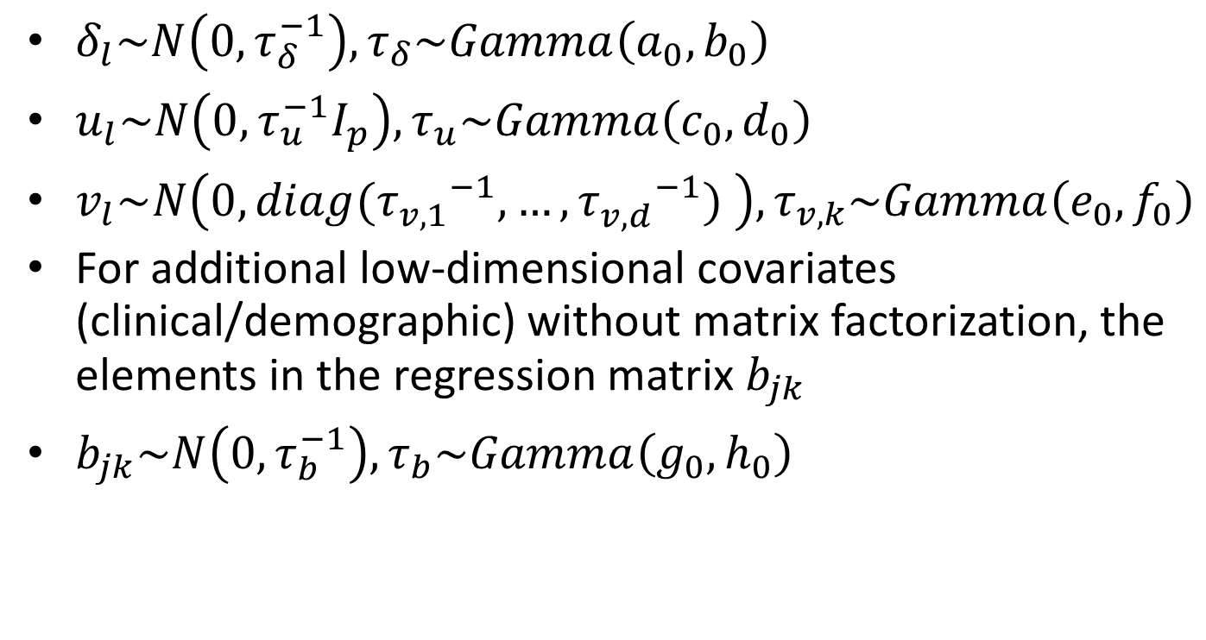
Prior Distributions
$δ_{l}\sim N\left(0,τ_{δ}^{−1}\right), τ_{δ}\sim Gamma\left(a_{0},b_{0}\right)$
$u_{l}\sim N\left(0,τ_{u}^{−1}I_{p}\right), τ_{u}\sim Gamma\left(c_{0},d_{0}\right)$
$v_{l}\sim N\left(0,diag({τ_{v,1}^{}}^{−1},…,{τ_{v,d}^{}}^{−1}) \right), τ_{v,k}\sim Gamma\left(e_{0},f_{0}\right)$
For additional low-dimensional covariates (clinical/demographic) without matrix factorization, the elements in the regression matrix $b_{jk}$
$b_{jk}\sim N\left(0,τ_{b}^{−1}\right), τ_{b}\sim Gamma\left(g_{0},h_{0}\right)$

Slide 4
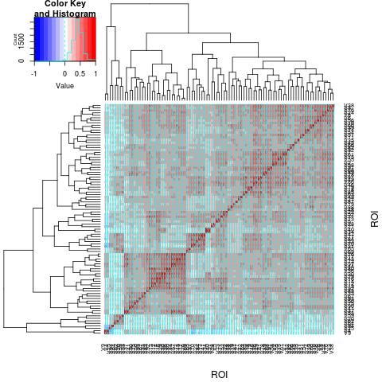
Unstructured Spatial Correlation of ROIs
Use Bayesian Factor Model
$e_{i}=Λη_{i}+ξ_{i}$

Slide 5
Run the Matlab Program
The main program is GLRRmain.m
Modify line5 – line 17 for some constants and hyperparameters
Modify line21 – line 23 for input filenames
If you want to modify the hyperparameters for the infinite factor model, please modify the lines 7-10 of file MlabFunctions/CovFactorLoading.m
Run GLRRmain.m
Change lines 3-8 of file PostProcessing.m to output estimates and plot figures.

