Slide 1
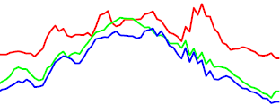
Functional Mixed Effect Models
Longitudinal Data
Spatial-temporal Process
Functional Mixed Effect Models
Objectives:
Dynamic functional effects of covariates of interest on functional response.

Slide 2
FMEM
Decomposition:
Global Noise Components
Local Correlated Noise
Ying et al. (2014). NeuroImage.
Zhu, Chen, Yuan, and Wang (2014). Arxiv.

Slide 3
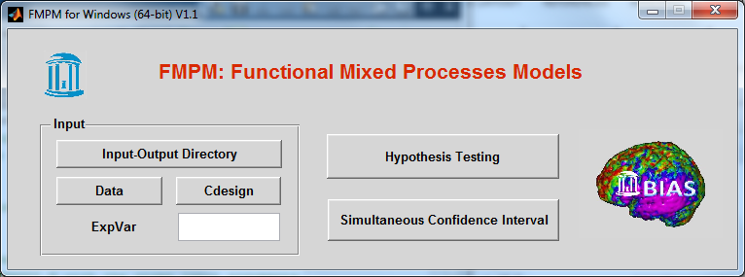
Functional Analysis of Diffusion Tensor Tract Statistics (FADTTS) pipeline
http://www.nitrc.org/projects/fadtts
FMPM GUI is a MATLAB graphical user interface

Slide 4
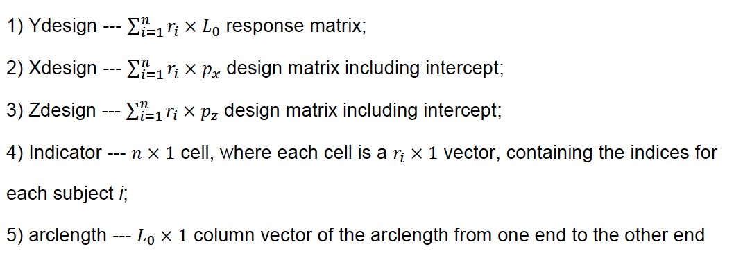
FADTTS
Specify input-output directory
Prepare input data

Slide 5
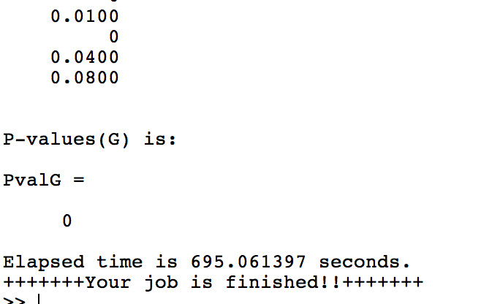
FADTTS
Hypothesis Testing
Specify the contrast matrix and the corresponding zero vector, say Cdesign=[0,1,0]; and B0vector=zeros(1,L0);
specify ExpVar. E.g., ExpVar=0.99;
PvalG.mat and PvalL.mat
HT_FMPM_Example.m (non GUI)

Slide 6
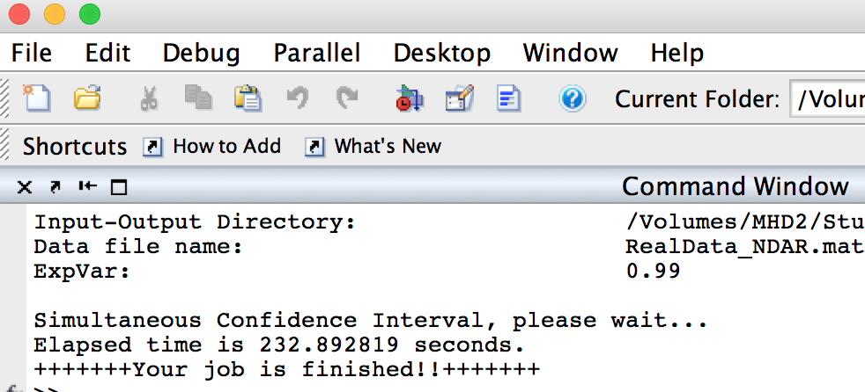
FADTTS
Simultaneous Confidence Interval
Same as Hypothesis Testing
LowerBd.mat and UpperBd.mat (alpha = 0.05, and 0.01)
SB_FMPM_Example.m (non GUI)

Slide 7
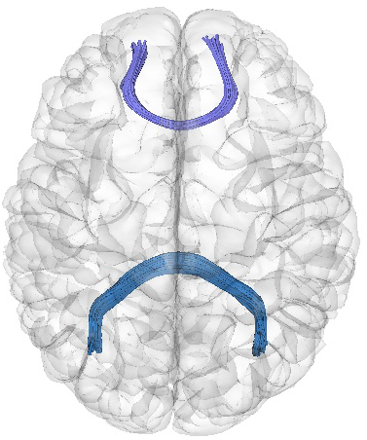
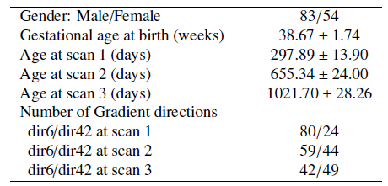
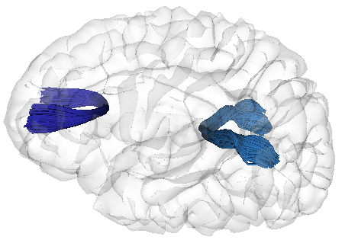
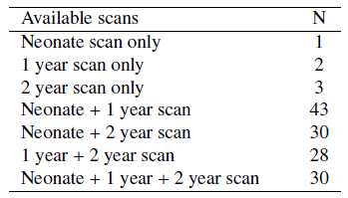
Real Data
genu
DTImaging parameters:
TR/TE = 5200/73 ms
Slice thickness = 2mm
In-plane resolution = 2x2 mm^2
b = 1000 s/mm^2
One reference scan b = 0 s/mm^2
Repeated 5 times when 6 gradient
directions applied.

Slide 8
Real Data

Slide 9
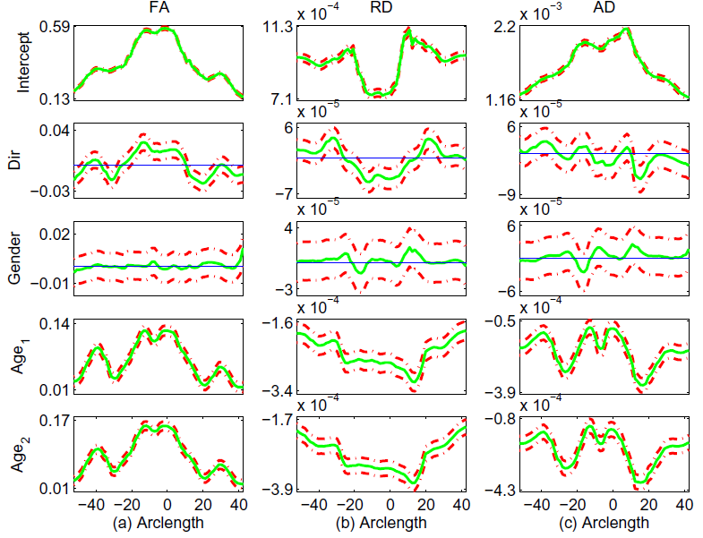
Real Data Analysis Results

