Slide 1
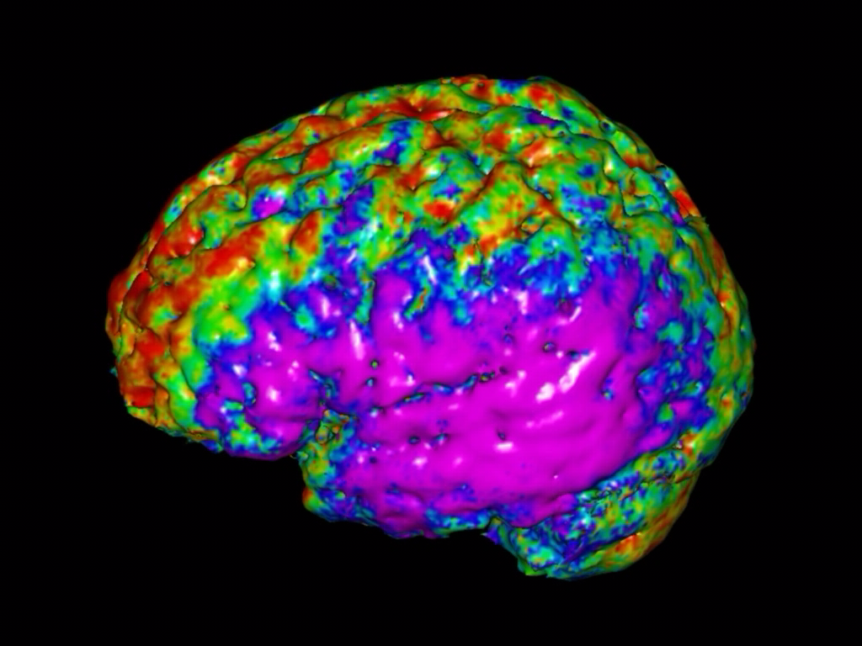
Emerging Issues for Neuroimaging
Statistics and Statisticians
Hongtu Zhu, Ph.D.
Department of Biostatistics and Biomedical Research Imaging Center
University of North Carolina at Chapel Hill

Slide 2
Acknowledgement:
Some pictures and slides were copied from multiple resources including Suetens (2009), Fass (2008), Dr. Niethammer, Dr. Dryden, Dr. Qiu, Dr. Linquist, Dr. Geido, Dr. Srivastava, Dr. Styner, Dr. Pizer, Dr. Fessler, google, Wiki, gustaf@cb.uu.se, etc.
http://www.bios.unc.edu/research/bias/lecture.html

Slide 3
Part 1. Organization

Slide 4

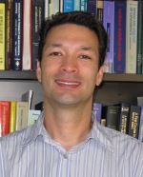

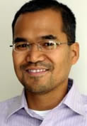
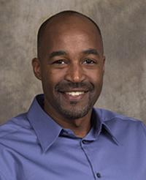
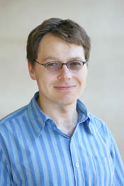
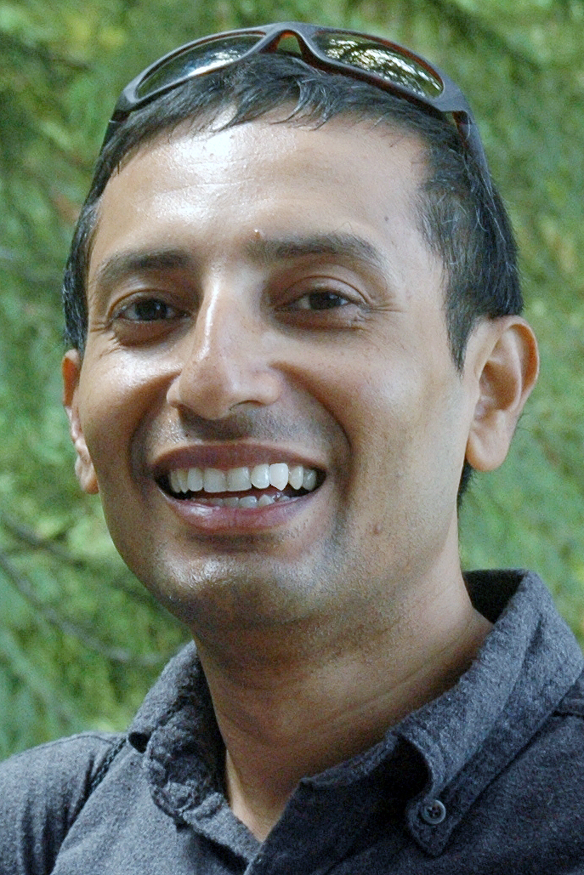


SI and SINS
Statistics in Imaging (SI) within ASA
Advisory board committee members for SI:
Martin Lindquist, Daniel Rowe, Brian Caffo,
Hernando Ombao, F. Dubois Bowman, Thomas Nichols,
Ranjan Maitra, Hongtu Zhu, Kary Myers.
Society of Imaging Neuroscience Statisticians (SINS)
http://www.mscs.mu.edu/~dbrowe/sins.html
Roundtables in ENAR 2011 and JSM 2011.

Slide 5
Progress
A well-written charter for the proposed Section.
Over 139 signatures for forming SI from ASA members
The necessary materials and have submitted them to the Council of Sections Governing Board.
A motion for chartering will be presented at the next annual meeting of the Council of Sections in August.
A mail or e-mail ballot of the Council of Sections will be taken on the issue by October 1 of the same year.
If approved by a majority vote of the Council of Sections, the new Section will be officially chartered as of January 1st, 2012.
Voting for the officers of the SI.

Slide 6
Acting Officers for the SI:
2010-11: Chair Daniel Rowe, Secretary Brian Caffo, Treasurer DuBois Bowman, Rep to COS Kary Myers, Program Chair Ranjan Maitra
2011-12: Chair Hongtu Zhu, Secretary Brian Caffo, Treasurer DuBois Bowman, Rep to COS Kary Myers Program Chair Martin Lindquist.
NeuroStat Google Group
http://groups.google.com/group/neurostat/

Slide 7
Goals
To disseminate thoroughly tested statistical software and tools
fMRI, DTI, EEG, EMG, PET, Population Statistics, … .
To promote using correct statistics and developing novel statistical methods in neuroimaging.
To increase the visibility and recognition of statistician in the neuroscience community.
To exploring stronger working collaborations among different groups.

Slide 8
Part 2. Imaging Science

Slide 9
Imaging Science
From Wikipedia, the free encyclopedia
Imaging Science
is a multidisciplinary field concerned with the generation, collection,
duplication, analysis, modification, and visualization of images.
As an evolving field, it includes research and researchers from
Physics, Mathematics, Statistics, Electrical Engineering, Computer
Vision, Computer Science and Perceptual Psychology.

Slide 10
Three key components of imaging science
Image acquisition: studies the physical mechanisms
and mathematical models and algorithms by which
imaging devices generate image observations.
Image interpretation/application: is to see, monitor, and
Interpret the targeted world/patterns being imaged.
Image processing: is any linear or nonlinear operator
that operates on the images and produces targeted
patterns.

Slide 11
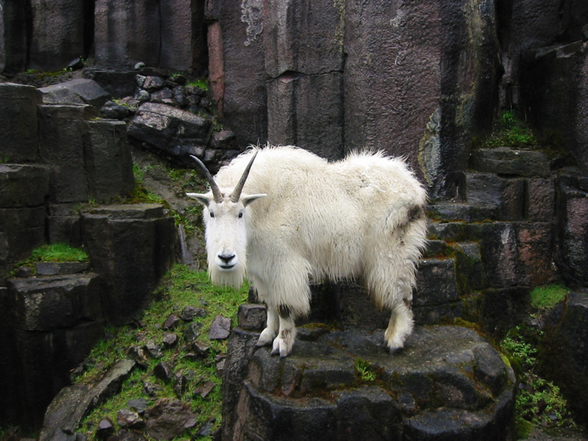
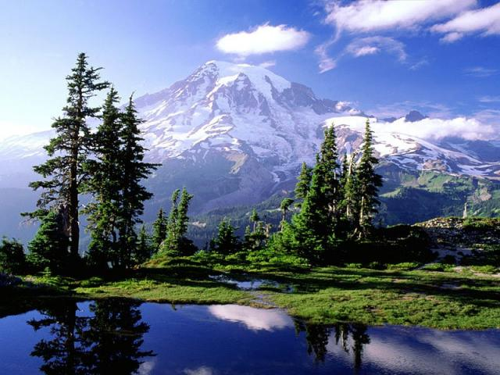

What is image?
(i) In computer science an image is an exact replica of the
contents of a storage device (a hard disk drive or CD-ROM for
example) stored on a second storage device.
(ii) is an optically formed duplicate or other reproduction of an
object formed by a lens or mirror.

Slide 12
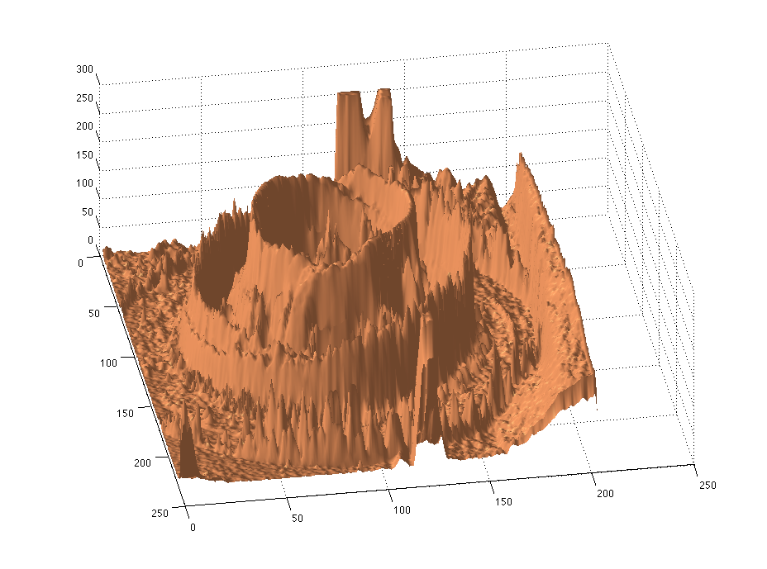
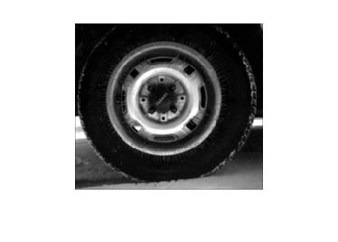
Mathematics. Image is the point or set of points in the range corresponding
to a designated point in the domain of a given function.
As
Additional Conditions:

Slide 13
Digitized Images
Sampling (grid points):
An ordered array or a triangular array or etc;
A set of small cells of the same shape and size
(pixels, voxels).
Sometime, it involves interpolation.
Sampling Rate ensure that all the relevant information
contained in the image is largely retained by sampling.
Quantization: is a process of assigning the function value
at each sampling point to one of the finite set of integers.

Slide 14
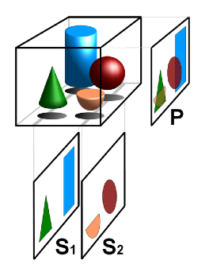
General Digital Image
Spatial parameters
Time parameters
Spectral parameters
A limited range of values
Spatial resolution
Temporal resolution
Spectral resolution
Range of wave-length
Number of color
Gray scale resolution

Slide 15
Part 3. Imaging Modalities and Opportunities

Slide 16
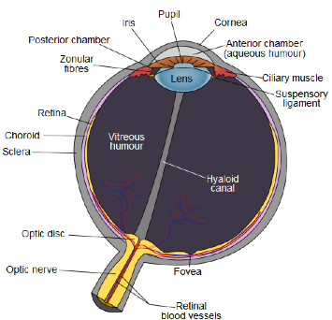
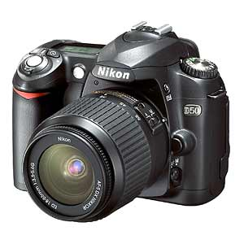
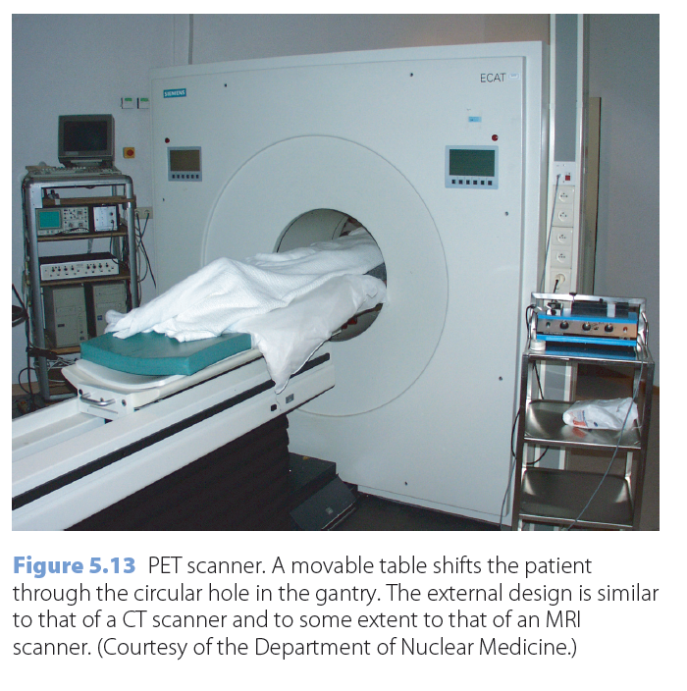
Imaging Devices

Slide 17
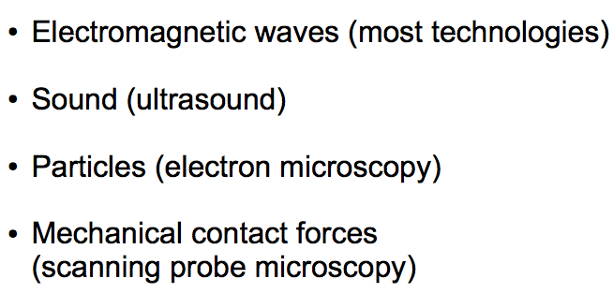
Targets

Slide 18




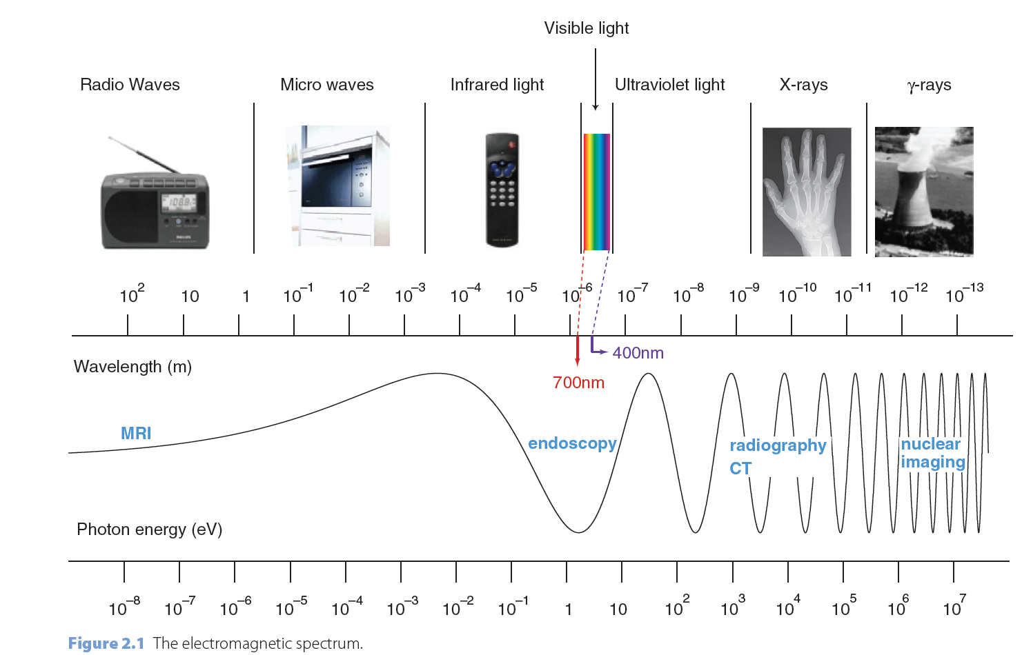
Electromagnetic Waves
nm (nanometer, E-9m)

Slide 19
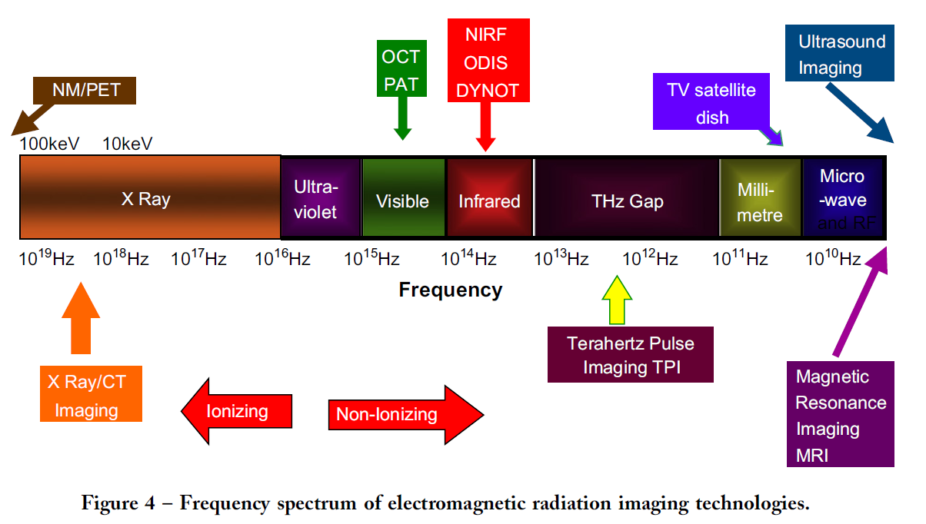
Electromagnetic Imaging

Slide 20
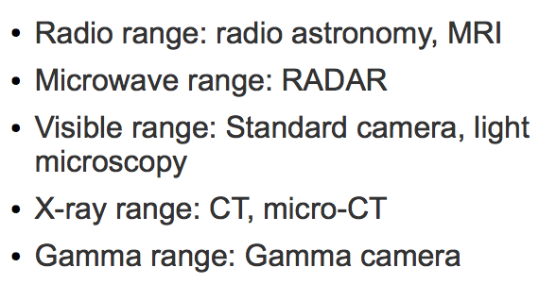
Electromagnetic Imaging

Slide 21
Medical imaging
From Wikipedia, the free encyclopedia
Medical imaging is the technique and process used to create images of the human body (or parts and function thereof) for clinical purposes (medical procedures seeking to reveal, diagnose or examine disease) or medical science (including the study of normal anatomy and physiology).
2010, 5 billion medical imaging studies were done worldwide.

Slide 22
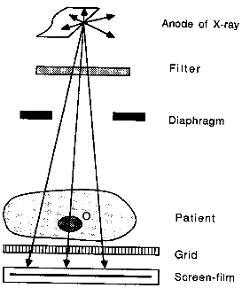
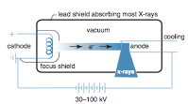
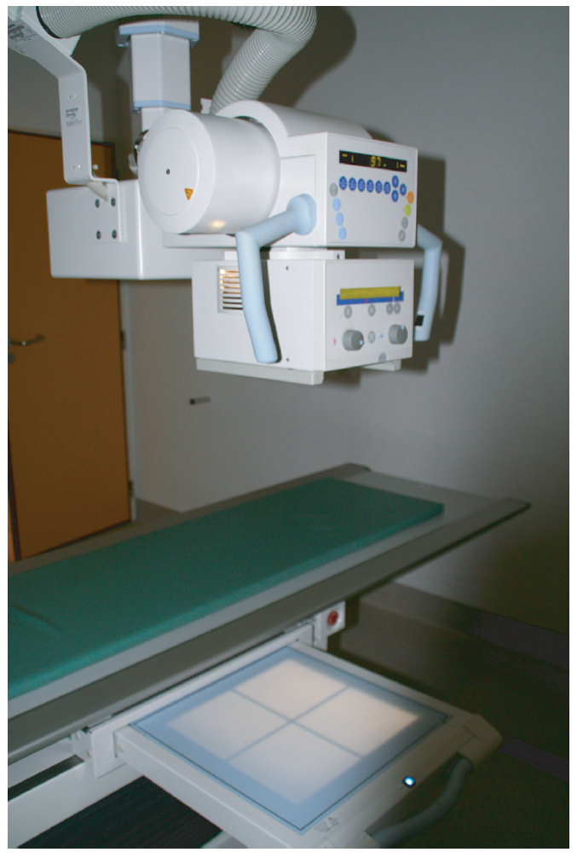
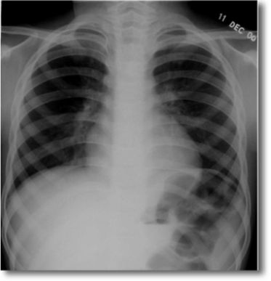
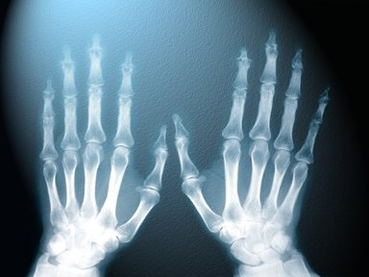
X-rays are ionizing waves
consisting of photons traveling at the speed of light with energy E=hf
X-rays produced by a tube.
Filtered to removed undesired energy.
Restriction to illuminate organ of interest.
Grid removes scattered radiation.
Recording of image on electronic
plate (or film).

Slide 23
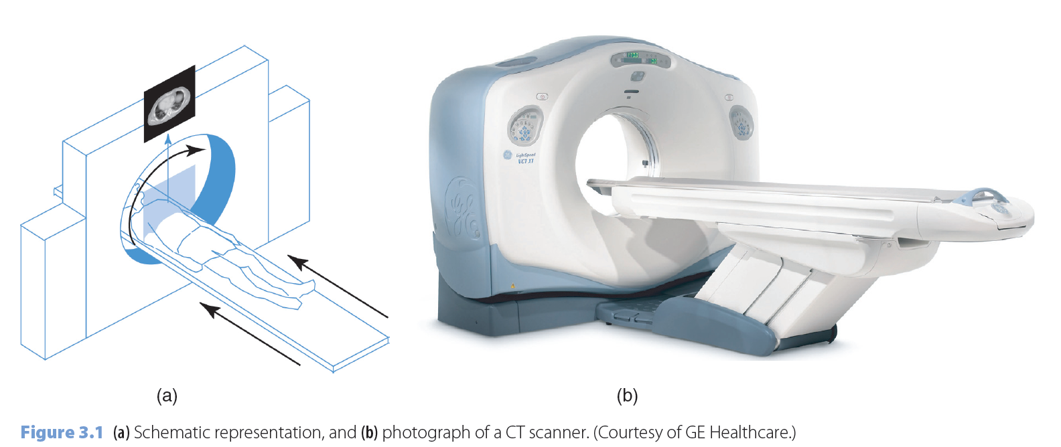
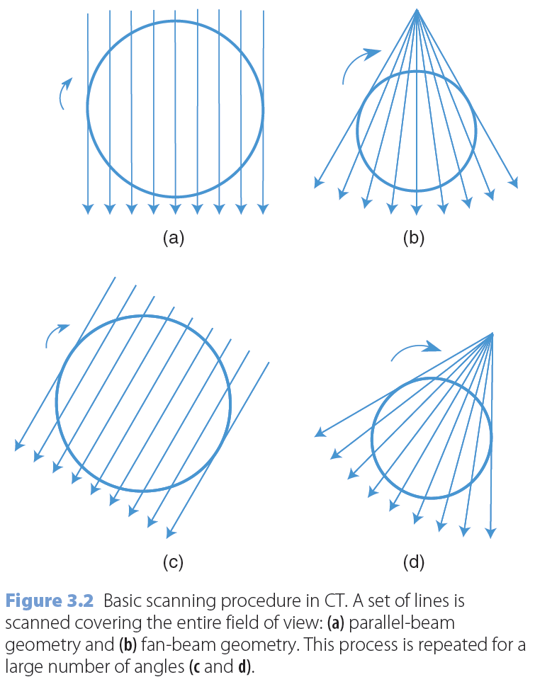
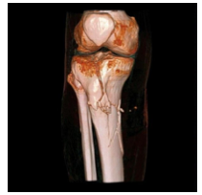
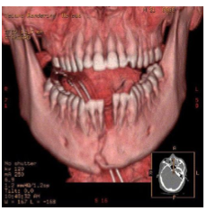
Computed Tomography (3D X-rays)
is a imaging method employing
tomography created by computer. Digital geometry processing is used to
generate a 3D image of the inside of an object from a large series of 2D X-ray
images taken around a single axis of rotation.

Slide 24
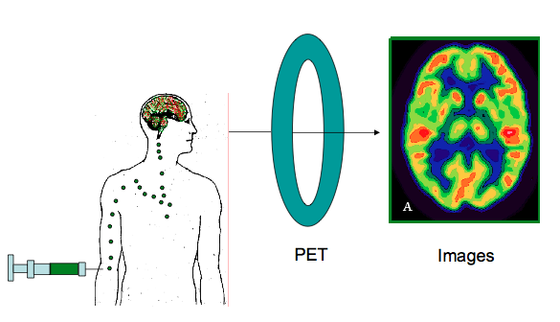
SPECT and PET

Slide 25
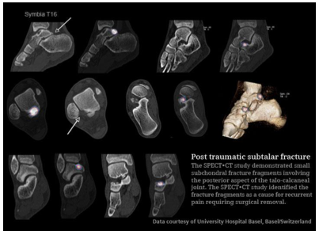
SPECT=Single-Photon Emission Computed Tomography
is a nuclear medicine tomographic imaging technique using gamma rays for
measuring the blood flow to the brain.
Radio-labeled chemical (ECD or
HMPAO) is quickly injected at time of
seizure onset to detect the region of
increased blood flow, which is
associated with seizure activity.
By comparing the ictal scan (imaged
during seizure) and the interictal scan
(imaged without seizure), the regions
of activation in the brain are detected
to locate the seizure origin.
http://www.youtube.com/watch?v=l6V6VLxQlkY

Slide 26
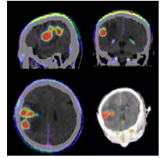
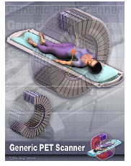
PET=Positron Emission Tomography
is a functional imaging
technique to extensively study the relationship between energy consumption
and neuronal activity. It uses positron-emitting radioactive tracers that are
attached to molecules that enter biological pathways of interest.
FDG: Fluorodeoxyglucose (similar to Glucose).
Brain uses glucose as major source of energy.
Normal brain picks up FDG in a large amount.
In epilepsy, the brain cell (neuron) does not function
right or the neurons are lost due to a variety of reasons.
FDG-PET scan detects the regions of brain where the
Glucose uptake is low (hypo-metabolism), which is often
associated with the site of seizure origin.

Slide 27
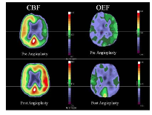
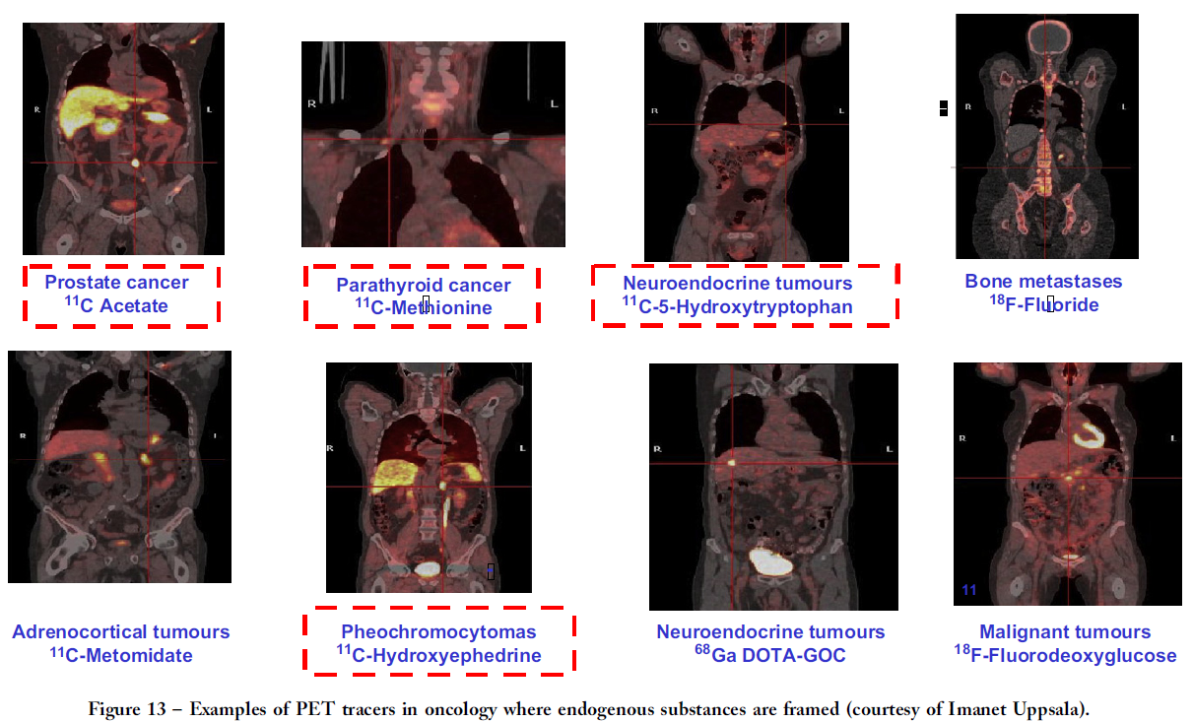
PET measures
PET tracers
Reduced Cerebral Blood Flow
(CBF) and elevated compensatory
Oxygen Extraction (OEF) before
and after carotid artery angioplasty
(stroke risk)

Slide 28
PET and SPECT
PET and SPECT scan is different from CT, MRI or Ultrasound,
which detect structure changes and anatomy, can provide
physiological and molecular information of brain.
PET and SPECT are clinically indicated for pre-surgical
localization of seizure origin. They are covered by most
insurance providers.
They provide valuable seizure localization information in
addition to MRI scan, EEG and clinical assessment to the
surgeons.

Slide 29
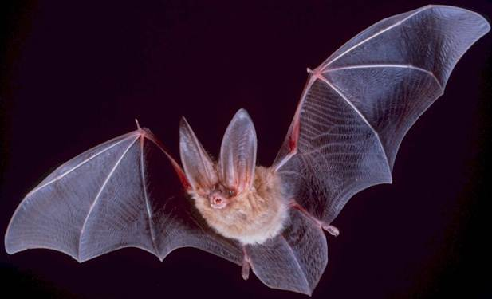
Ultrasound imaging
involves exposing part of the body to high-frequency sound waves to produce pictures of the inside of the body.
Because ultrasound images are captured in real-time, they
can show the structure and movement of the body’s internal
organs, as well as blood flowing through blood vessels.
When a sound wave strikes an object, it bounces back, or
echoes. By measuring these echo waves it is possible to
determine how far away the object is and its size, shape, and
consistency (whether the object is solid, filled with fluid, or both).
In medicine, ultrasound is used to detect changes in appearance
of organs, tissues, and vessels or detect abnormal masses, such
as tumors.

Slide 30
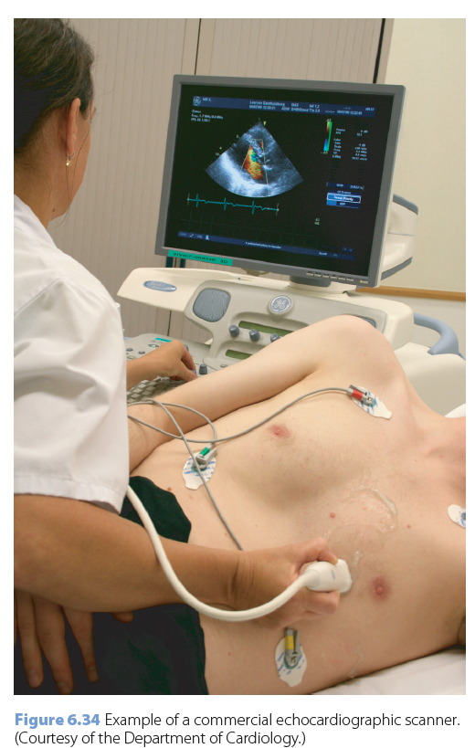
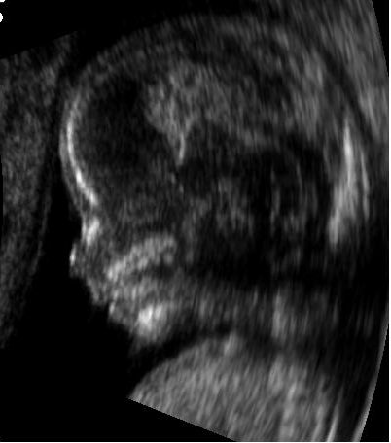
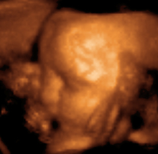
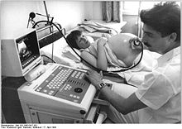
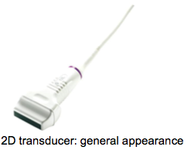

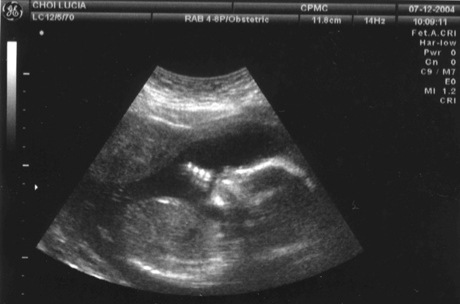
Fetus at 14 weeks
Fetus at 29 weeks

Slide 31
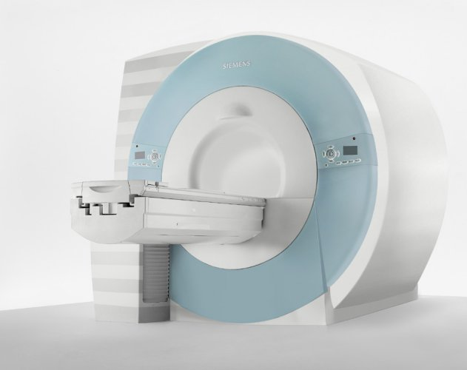
Magnetic Resonance Imaging (MRI)
is to visualize detailed internal
structures. The good contrast is provides between the different soft tissues of the
body make it useful in brain, muscles, heart, and cancer.
No ionizing radiation.
It uses a powerful magnetic field to align the magnetization
of some atoms in the body, then uses radio frequency fields
to systematically alter the alignment of this magnetization.
This causes the nuclei to produce a rotating magnetic field
detectable by the scanner.
Paul Lauterbur and Peter Mansfield were awarded the 2003 Nobel Prize
in Physiology or Medicine for their "discoveries concerning magnetic resonance imaging".
http://www.youtube.com/watch?v=6_2D3Lh1v74&feature=related

Slide 32
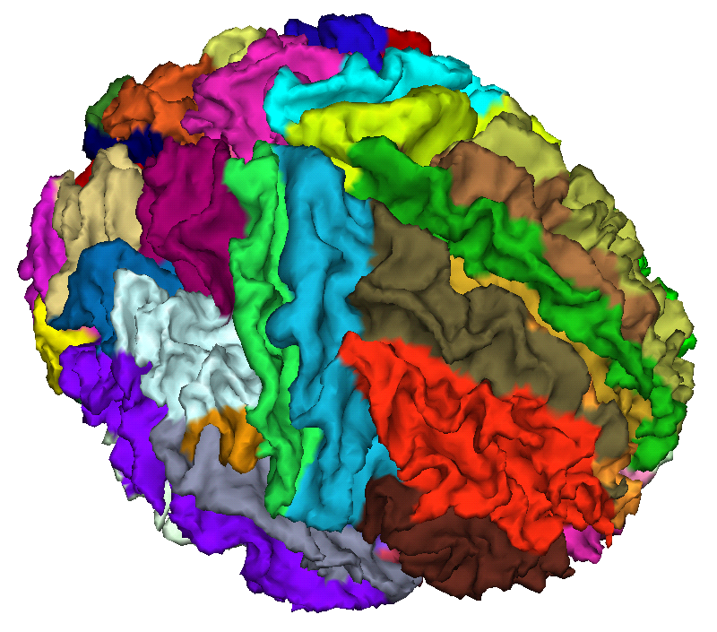
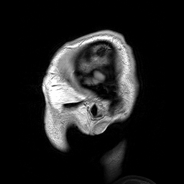
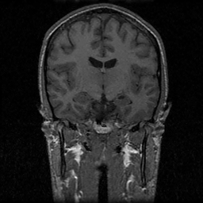
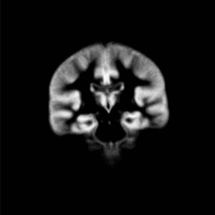
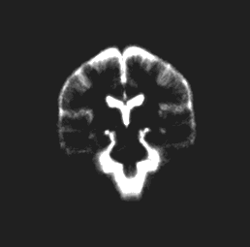
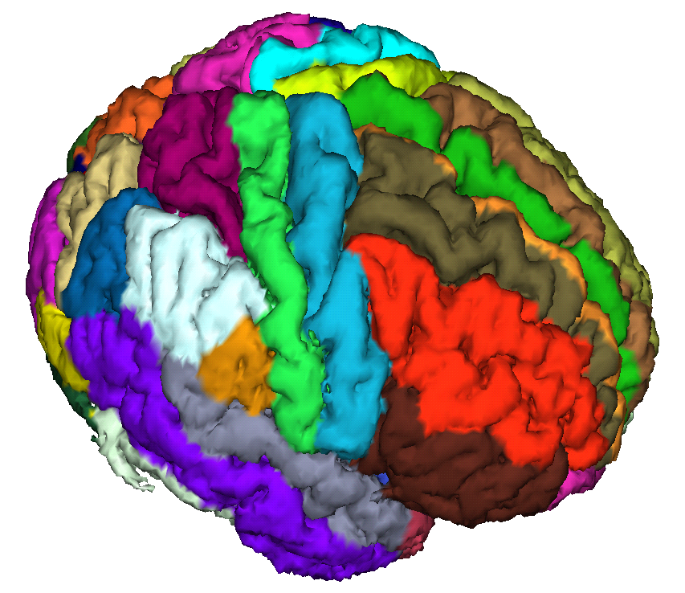
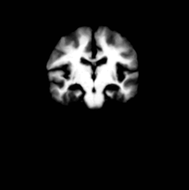
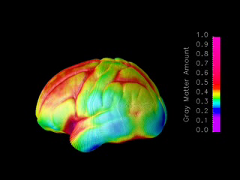
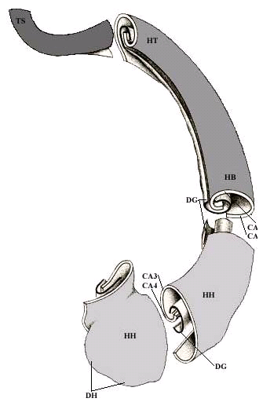

Magnetic Resonance Imaging (MRI)

Slide 33




Functional MRI
measures the hemodynamic response (change in blood flow)
related to neural activity in the brain or spinal cord of humans or other animals.
Since the early 1990s, fMRI has come to dominate the brain mapping field due to
low invasiveness, absence of radiation exposure, and relatively wide availability.
Input
U₁u₁
Input
U₂u₁
group 1
group 2
region
x₁
region
x₂

Slide 34







Diffusion MRI
can provide information about damage to parts of the nervous system and about white matter connections among brain regions.
http://www.youtube.com/watch?v=XwUn64d5Ddk&feature=related

Slide 35
Molecular Imaging
originated from the field of radiopharmacology to better understand the molecular pathways inside organisms.
Molecular imaging uses biomarkers to help image particular targets or
pathways. Probes interact chemically with their surroundings and in turn alter
the image according to molecular changes occurring with the area of interest.
This process is markedly different from previous methods of imaging which
primarily imaged differences in qualities such as density or water content.
This ability to image fine molecular changes opens up an incredible number of
exciting possibilities for medical application, including early detection and
treatment of disease and basic pharmaceutical development.
Molecular imaging allows for quantitative tests, imparting a greater degree of
objectivity to the study of these areas.

Slide 36




Slide 37
Part 4. Challenges and Strategies

Slide 38
Conferences
Methodology
Publications
Data Sets
Software
Training
References
Grants
References

Slide 39






SI and Giants
flickr.com
blog.transparency.org

Slide 40
Giants
Society for Industrial and Applied Mathematics
IEEE Computer Society
IEEE Signal Processing Society
Organization for Human Brain Mapping
International Society for Magnetic Resonance in Medicine
Medical Image Computing and Computer Assisted Intervention

Slide 41
Conferences
SIAM Conference on Imaging Science (IS12)
Human Brain Mapping
IEEE Conference on Computer Vision and Pattern Recognition
Medical Image Computing and Computer Assisted Intervention
Information Processing in Medical Imaging
Neural Information Processing Systems Foundation

Slide 42
Methodology
The reconstruction, enhancement, segmentation, analysis, registration,
compression, representation, and tracking of two and three dimensional
images are vital to many areas of science, medicine, and engineering.
Sophisticated mathematical, statistical, and computational methods
include transform and orthogonal series methods,
nonlinear optimization, numerical linear algebra,
integral equations, partial differential equations,
Bayesian and other statistical inverse estimation methods,
operator theory, differential geometry, information theory,
interpolation and approximation, inverse problems,
computer graphics and vision, stochastic processes,
and others.

Slide 43
Publications
SIAM Journal on Imaging Sciences
IEEE Pattern Analysis and Machine Intelligence
NeuroImage
IEEE Transactions on Medical Image
IEEE Transactions on Signal Processing
IEEE Transactions on Image Processing
Annals of Applied Statistics
IEEE Transactions on Signal Processing Magazine
Medical Imaging Analysis
Human Brain Mapping
Biometrics
Biostatistics
Journal of American Statistical Association ACS

Slide 44
Data Sets
Public Data Sets:
1000 Functional Connectomes Project
Alzheimer’s Disease Neuroimaging Initiative (ADNI)
NIH MRI Study of Normal Brain Development
Human Connectome Project

Slide 45
Software
http://www.nitrc.org/
NITRC = The Source for Neuroimaging Tools and Resources
Statistical Parametric Mapping (SPM)
FMRIB Software Library (FSL)
Analysis of Functional NeuroImages (Afni)
3D Slicer
FreeSurfer

Slide 46
Common platform for statistical toolboxs
Statistical Plug-Ins for Neuroimaging Network (SPINN)
  is a stable computing platform that will allow cutting edge statistical techniques to be combined with state of the art visualization and data management tools.
  provides tools for reading, analyzing and visualizing neuroimaging data that can easily be combined with statistical modules (or plug-ins) written by outside developers.
  is a highly extensible programming, analysis, and image-producing environment that will allow new statistical techniques to quickly become available to the broader neuroimaging research community.

Slide 47









Visualization Tools
Data plots
Surface renderings
Subcortical surfaces
Transparent surfaces
Functional connectivity
Multi-pane, linked orthviews
Montages
Multidimensional scaling plots

Slide 48
Training
Courses on Imaging Statistics and Statistical Computing
Introductory Training Courses in ENAR and JSM
Advanced Imaging Statistical Courses in HBM and MICCAI
Applying Imaging Related Training Grants.
Collaborating with Statisticians from other universities
Attracting good students and scholars

Slide 49
Grants
National Science Foundation
National Institute of Mental Health
National Institute of Biomedical Imaging
National Cancer Institute
BMRD Study Section

Slide 50
References
Cao, F., Lisani, J. L., Morel, J. M., Muse, P., and Sur, F. (2008). A Theory of Shape Identification, Lecture Notes in Mathematics, Springer.
Chen, T. F. and Shen, J. (2005). Image processing and analysis: variational, PDE, wavelet, and stochastic methods. Siam.
Dryden, I.L. and Mardia, K.V. (1998). Statistical Shape Analysis, Wiley, Chichester.
Grenander, U. and Miller, M. (2007). Pattern Theory: From Representation to Inference. Oxford University Press.
Huettel, S. A., Song, A. W., and McCarthy, G. (2009). Functional Magnetic Resonance Imaging, Second Edition. Sinauer Associates.
Lazar, N. A. (2008). The Statistical Analysis of Functional MRI Data. Springer, New York.
Liang, Z. P. and Lauterbur, P. C. (2000). Principles of Magnetic Resonance Imaging. IEEE press.
Modersitzki, J. (2004). Numerical Methods for Image Registration. Oxford University Press, New York.
Qiu, P. (2005). Image Processing and Jump Regression Analysis. Wiley Series in Probability and Statistics.

Slide 51
Part 5. Research Challenges

Slide 52
Imaging Sequence
Imaging Reconstruction
Imaging Signal Model
Imaging Registration
Imaging Segmentation
Shape Analysis
Population Statistics

Slide 53
Imaging Sequence
Evaluation and Optimization
Statistical Methods in Diagnostic Medicine
Experimental Design

Slide 54


Evaluation
3 Types of Excitation
∆t
Single F/1.5
(SP1.5)
Single F/3
(SP3)
Double F/1.5
(DP)
3 Types of Tracking
Lat
Lat
Lat
Single A-line RX
(SRx)
4:1 Parallel RX
(ParRx)
SWEI
Combine for 9 Total Sequences
Notes:
Custom atherosclerosis mimicking phantoms and excised pig iliac arteries both atherosclerotic and non-atherosclerotic

Slide 55

ROC
** p<0.02
*** p<0.005

Slide 56







Optimization
Acquisition Scheme
(Imaging Parameters)
Puled-gradient spin-echo (PGSE) sequence
Noisy Images
Images Reconstruction

Slide 57

Statistical Model
Gradient Orientations &
b factors
Design Criterion
Global Optimization
Gradient directions (Hasan & Narayana, 2005,
MedicaMundi)

Slide 58
Imaging Reconstruction
Variable Selection Problem
Optimization

Slide 59
MRI Measurement Model
Under-determined problem

Slide 60
Discrete-discrete Formulation
Goal is to estimate
Estimate object by minimizing a cost function:
• Negative log-likelihood of Gaussian distribution
• Equivalent to maximum-likelihood (ML) estimation
Issues:
• computing minimizer rapidly
• stopping iteration (?)
• image quality

Slide 61


Slide 62
Estimate object by minimizing a cost function:

Slide 63


Quadratic Penalization
1D example: squared differences between neighboring pixel values:
where
For 2D and higher-order differences, modify differencing matrix C.
Leads to closed-form solution (a formula of limited practical use):

Slide 64
Model-Based Image Reconstruction
MR signal equation with more complete physics:

Slide 65


Sensitivity encoded (SENSE) –SENSE-ITIVE
Use multiple receive coils (requires multiple RF channels).
Exploit spatial localization of sensitivity pattern of each coil.
RF coil sensitivity patterns

Slide 66
Imaging Signal Model
Parametric Models
Nonparametric Models

Slide 67
Data
Rician Regression or
Log-linear Model
Estimated Diffusion Tensor
y
Estimated Eigenvalues or
Eigenvectors
x
z

Slide 68


Quantifying Uncertainty by
using bootstrap methods
A
A
B
B
Repetition
Wild
Repetition
Wild
Bootstrap

Slide 69



BOLD: Multiple Sequences of Events
+
=
+

Slide 70

Bold Model with Multiple Events
Time-domain Models:
Convolution Model
Convolution Model:

Slide 71









Slide 72
Imaging Segmentation
Cluster Analysis
Markov Random Field
Partial Differential Equation

Slide 73






Slide 74


[Image: Mumford]
The Mumford Shah model is a method that yields a segmentation and at the same time a (piece-wise smooth) image reconstruction.

Slide 75


Alternative approach through graph construction (vs. PDE)
Example: Binary Segmentation
Need to partition the picture into foreground and background.
Images from ECCV Tutorial, Kumar/Kohli

Slide 76



Segmentation by Graph-Cut
Optimization Problem: Minimize
Looking at it on a pixel-by-pixel basis (where f is the labeling):
Problem: We cannot try all possible pairings for the labels f.
Need an efficient algorithm to solve this problem.

Slide 77

Segmentation
Registration

Slide 78
Imaging Registration
Registration Methods
Infinite-dimensional Statistics

Slide 79




Image Registration
Image registration is the process of transforming different sets of data into one coordinate system. Data may be multiple photographs, data from different sensors, from different times, or from different viewpoints.

Slide 80

Feature-based
Intensity-based

Slide 81


Slide 82
Large Deformation Diffeomorphic Metric Mapping
Nonparametric Local Linear Model

Slide 83


Atlas-Building
Davis et al. [2007]
Durrleman et al. [2009]

Slide 84

Longitudinal Atlas-Building
Objective: Obtain an estimate of an average temporal trajectory and its
variation from a set of subjects each imaged at multiple time-points.
MRI feature image
for registration
(here: FA)

Slide 85



Effect of Registration and Atlas-Building on Statistics
MRI feature image
for registration
(here: FA)

Slide 86
Shape Analysis
Differential Geometry
Statistical Shape Theory
Nonparametric Methods

Slide 87

What is Shape?

Slide 88


Kendall/Dryden & Mardia:
Shape is all the geometrical information that remains when location,
scale and rotational effects are filtered out from an object.

Slide 89



Medial Representation

Slide 90


Slide 91





FreeSurfer
Cortical Reconstruction
and Automatic Labeling
Inflation and Functional
Mapping
Automatic Subcortical
Gray Matter Labeling
Surface Flattening
Surface-based Intersubject
Alignment and Statistics
Automatic Gyral White
Matter Labeling

Slide 92


Shape Representation using Basis functions

Slide 93
Population Statistics
Regression Analysis
Longitudinal Data Analysis
Multivariate Data Analysis
Functional Data Analysis
Nonparametric Smoothing Methods

Slide 94



Manifold-valued Data
Riemannian Response Space: Riemannian manifold is connected and geodesically complete
Euclidean Covariate
Space
Link Function

Slide 95

Semiparametric and Nonparametric Regression for
Manifold-valued Response from Cross-sectional,
Longitudinal and Family-based Neuroimaging Studies

Slide 96






White Matter Maturation
Week 2
Week 2
Year 1
Year 1
Year 2
Year 2

Slide 97






Sample Data
Right internal capsule: a collection of axons
connecting the cerebral cortex and the brain stem
diffusion properties or diffusion tensors
(e)
grids
covariates

Slide 98
Multivariate Varying Coefficient Model
Functional Principal Component Analysis
Decomposition:
Varying Coefficients
Low Frequency Signal
High Frequency Noise
Covariance operator:

Slide 99

Power Comparison between GLM and FADTTS

Slide 100

Functional Principal Component Analysis
FA
MD
Eigenvalues

Slide 101


All voxels are treated as independent units.
Initial smoothing step before the voxel-wise approach often blurs the image data near the edges of activated regions.

Slide 102
Multiscale Adaptive Regression Model (MARM)
Population Value Decomposition (PVD)
Li, Zhu, et al. (2010). JRSSB under revision.

Slide 103


Slide 104
Could one develop a unified framework integrating
registration and statistical model together?
Li, Zhu, et al. (2010). JRSSB under revision.

Slide 105


















Acknowledgements

