Slide 1



Roles and Responsibilities of Statisticians in Pharmaceutical Industry
March 24, 2022

Slide 2
Outline
  Introduction
  Roles and Responsibilities of Statistician at Bayer
    Core activities
    Leadership responsibilities
    Scientific opportunities
  Working groups within and outside Bayer
    Biostatistics Innovation Center
    PhRMA and BIO
    Scientific working groups
  Bayer Summer Internship Program

Slide 3
My Career
  Bayer Pharmaceuticals (2017 – Present)
    Executive Director, Global Head of Clinical Statistics (PAOW)
    Distinguished Bayer Science Fellow
  IQVIA/ Quintiles (2011-2017)
    Vice President, Global Head of Quantitative Decision Strategies and Analytics
  Inventive Health/ i3 Statprobe (2006-2011)
    Director, Head of Biostatistics Operations in Americas
  Pfizer (2004-2006)
    Manager, Clinical Statistics
  I3 Statprobe (1999-2004)
    Senior Biostatistician
  Nationwide Insurance Enterprise (1998-1999)
    Statistical Analyst

Slide 4
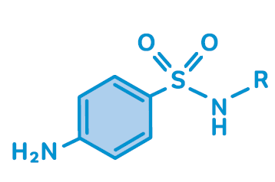

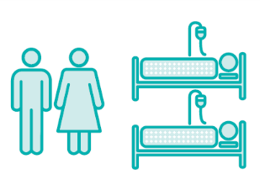


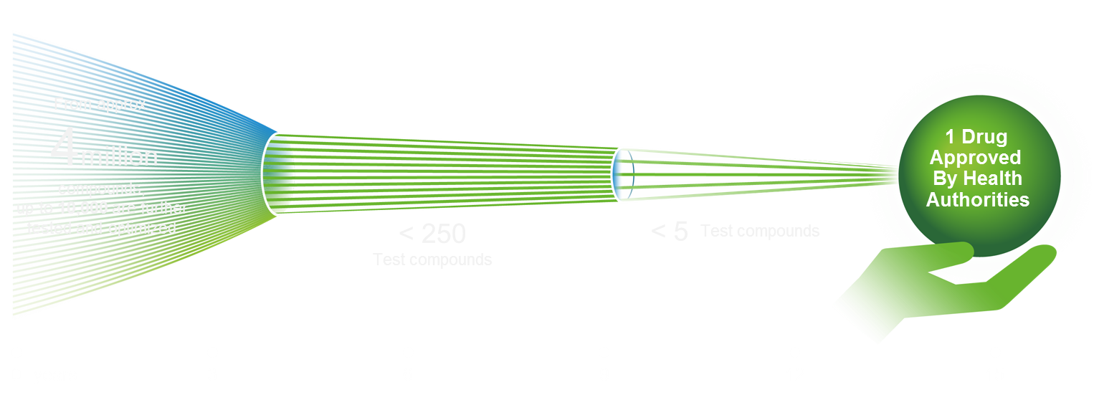

Drug development is a highly-regulated, long and costly endeavor with a low probability of success
1
2
3
4
5
Drug research
Preclinical tests
Clinical trials
Approval
After launch
Numbers…
  15 years…from idea to market approval
  >1 billion €… investment per asset until approval
  <1%...chance for a project to get approved
  12.4 years…average time effect. market exclusivity¹
  Permanent…benefit-risk assessment of products
1 JAMA Intern. Med. 2015, 175, p. 635-638
1 JAMA Intern. Med. 2015, 175, p. 635-638

Slide 5
Roles and Responsibility of a Statistician

Slide 6
Statistics & Data Insights (SDI) Department at Bayer
Introduction
  Statistics is an integral part of drug discovery, research and development.
  SDI is a center of strategic and operational excellence for statistical thinking, statistical methodology, and statistical applications.
  SDI statisticians are core members of multidisciplinary teams
  from early research to late-stage development.
  Our statisticians contribute to a scientifically based decision process utilizing efficient study design and best practice statistical analyses in accordance with regulatory requirements.
  Our special focus is on clinical development plans, clinical trial design and analysis, interpretation, and presentation of data.
  SDI Department has about 120 statisticians.
  Statisticians are located in the US, Germany, UK, Finland, China, and Japan.

Slide 7
Roles of Statisticians
  Therapeutic Area Level: TA Expert Statistician
  Methodology: Advisor/ Expert Statistician
  Compound (Drug) Level:
    Lead Project Statistician
  Project (Indication) Level:
    Project Statistician
    Deputy Project Statistician
    Early Development Project Statistician
    Project Biomarker Data Scientist
    Benefit-Risk Statistician
  Study Level:
    Study Statistician
    Statistical Operational Specialist
    Biomarker Data Scientist

Slide 8
Role of (Lead) Project Statisticians
  Role of Project Statisticians is ever-evolving:
    A member of Global Program Team (earlier assignment, at start of Phase I)
    Lead of the ‘Statistical Project Team’:
      Early Development Project Statistician, Integrated Analysis Statistician, Statistical Benefit-Risk Advisor, Statistical Methodology Advisor, Statistical Operational Specialist, Study Statisticians, Biomarker Data Scientists, Medical Affairs Statisticians.
  Close interaction with SDI line manager, Expert Statistician(s) and Statistical Methodology Expert Statistician(s).
  Project Statisticians are empowered to lead and should be willing to ask for help when needed.

Slide 9



Recommendations for regular interactions of Project Statisticians
TA/Statistical Methodology Expert Statistician
Line manager
  Primary focus: strategic consultation, statistical methods, scientific & regulatory aspects
  Resources, quality,
  leadership etc.
Lead-/(Early) Project Stat, SBRA/IA Stat, SMA, MA Stat etc.
Global Clinical Leader
CDS&A team
  Composition as needed
  Regular meetings or 1:1’s
  Exchange & align
  across projects
  Statistical topics
  Alignment & close collaboration
  Compound or project level
  One CDS&A
Notes:
Some ideas and talking points: collaboration structure is flexible and can be designed according to the teams needs/wishes; give some examples for potential meeting structure: Eliapixant - DS&A compound teams (core and extended) plus regular 1:1 with individual projects stats or meetings with project+study stat + SMA, plus regular meetings with both expert stats, regular interaction with REDS
Ask audience for their experience!

Slide 10
Lead Project Statistician
Project Statistician
Deputy Project Statistician
Project Statistician
Deputy Project Statistician
Lead Project Statistician
Project Statistician
…
Lead Project Statistician:
multiple indications/ projects
Project Statistician:
Single project (one indication)
Notes:
similar to the previous compound stat; not needed for every program, but for those with multiple projects or even indications; examples: Finerenone (Patrick), Eliapixant (Katrin) – name the respectice projects/indications and associated project stats

Slide 11
Leadership of Novel Activities
  Integration of Real-world data opportunities into Clinical Development Plan
  Leading discussion about estimands and implications on study design
  Developing, testing, using, or validating (novel) digital measures derived from digital tools
  Designing seamless studies (specifically, PoC/ Phase 2a + Phase 2b)
  Designing Studies with External Control Arm
  Quantitative Decision Making (QDM)
    Probability of success (PoS) and Prior elicitation
    Clinical Scenario Evaluation via Simulations
  Data Insight Generation (D.I.G)
  Handling of data-sharing requests

Slide 12
GBM AGILE Platform Trial
Glioblastoma Adaptive Global Innovative Learning Environment
  International phase 2/3 trial in newly diagnosed and recurrent glioblastoma patients
  Master Protocol that considers several experimental arms versus a common control
  New experimental arms can be added at any time, accrual rate permitting
  Primary endpoint: overall survival
  Seamless shift from learn (Stage 1) to confirm (Stage 2) in support of regulatory filing
  Concurrent and non-concurrent controls are used
  Response-adaptive randomization (Stage 1) and Bayesian stopping rules (PP) are implemented
  Led by KOLs in the field with involvement of FDA.
  Regorafenib was the first drug into this study
  Two additional investigational arms from other sponsors have been added within the past 6 months

Slide 13
GCAR: GBM AGILE Trial Sponsor*
Pharma Partner A
Arm A
* As Trial Sponsor, GCAR assumes oversight for regulatory, legal, contractual, financial, safety, stats, data management, quality assurance, drug management and distribution for GBM AGILE
GBM AGILE
TRIAL SPONSOR
Pharma Partner B
Arm B
Pharma Partner C
Arm C
Pharma Partner X
Arm X
CRO
Site management
Vendors
Medidata (EDC)
Covance (central lab)
Sites
Patient Enrollment & Management
KOLs
Almac (IXRS and Drug Depot)
Data monitoring
Safety management
Regulatory support
Arm PIs
Guidance on protocol development
Toxicity management
Clinical Ops
Berry Consultants (design, adaptive rand. stats)

Slide 14
Working Groups

Slide 15
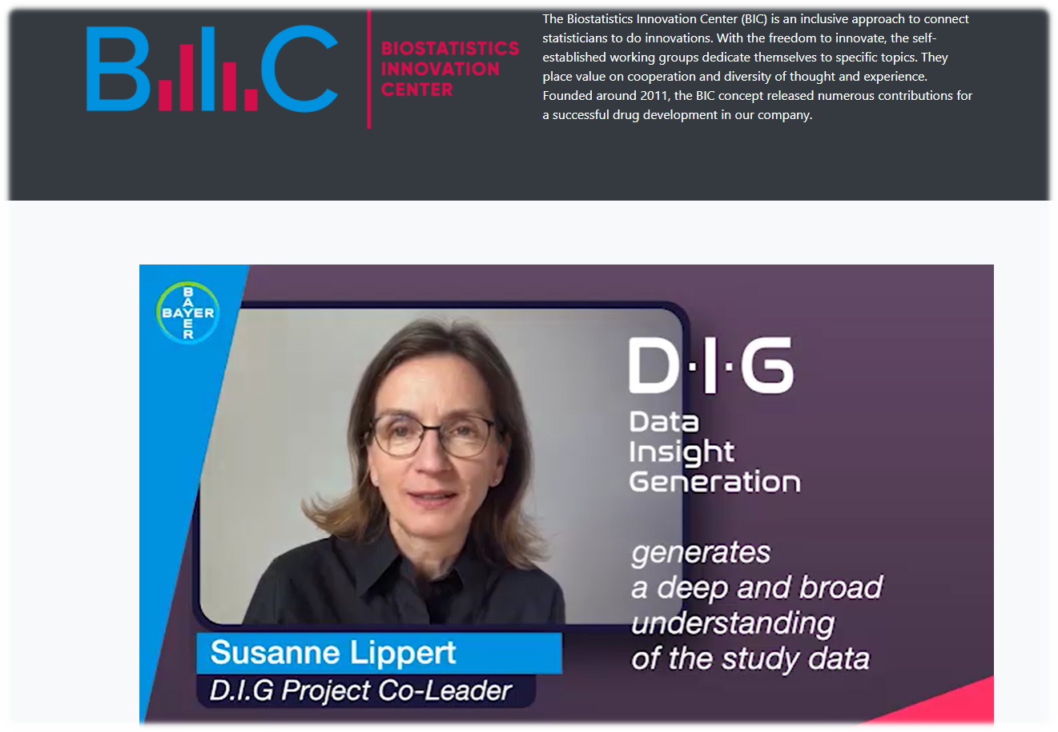
Bayer Biostatistics Innovation Center (BIC)
Connect statisticians to collaborate and innovate
  Topics include:
    Estimands
    Methodology for trials in small populations
    Data Insight Generation
    Bayesian Statistics
    Recurrent Events Analysis
    Dose Finding
    Basket Trial Designs
    Subgroup Analysis
    Benefit-risk Analysis
    Data Mining

Slide 16

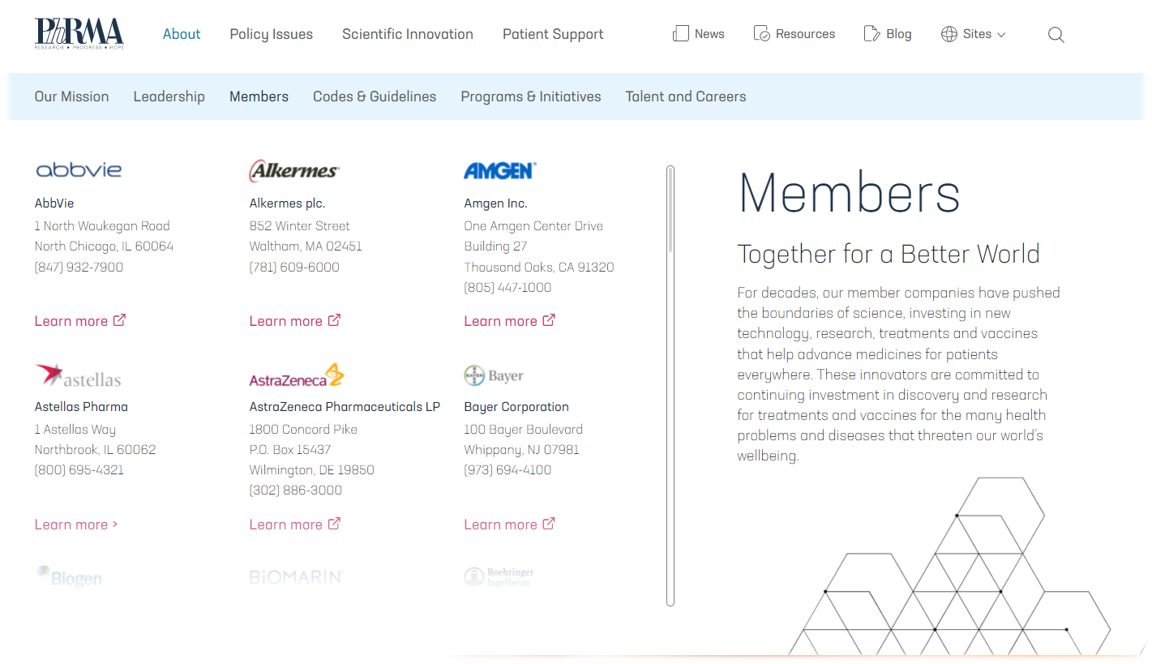
PhRMA (Pharmaceutical Research and Manufacturers of America)
Trade group representing pharmaceutical research and biopharmaceutical companies in the US

Slide 17
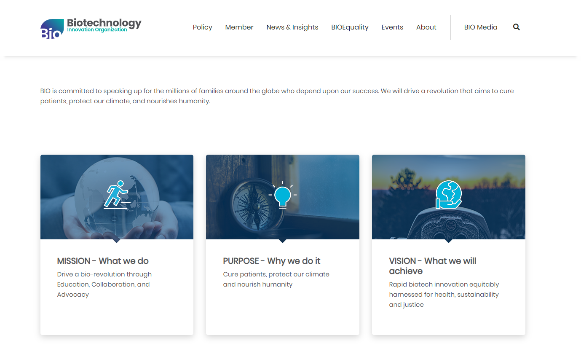
BIO (Biotechnology Innovation Organization)
Advocacy association representing member companies, state biotechnology groups, academic and research institutions, and related organizations across the United States and in 30+ countries

Slide 18
Professional Societies and Working Groups in US
  American Statistical Association (ASA), https://www.amstat.org/ :
    ASA Biopharmaceutical Section (https://community.amstat.org/biop/home)
      Working groups: Alzheimer’s Disease, Software, RWE, Safety, Oncology Statistical Methods, Estimands, Pediatric Drug Development, Nonclinical Biostatistics
    ASA Chapters, ASA Committees, annual ASA NJ/Bayer workshop
  International Biometric Society (IBS), https://www.biometricsociety.org/home:
    ENAR (Eastern North American Region), https://www.enar.org/
    WNAR (Western North American Region), https://wnarofibs.wildapricot.org/
  Drug Information Association (DIA), https://www.diaglobal.org/
  Clinical Trials Society (SCT), https://www.sctweb.org/
  American Society of Clinical Oncology (ASCO), https://www.asco.org

Slide 19
Summer Internship Program

Slide 20
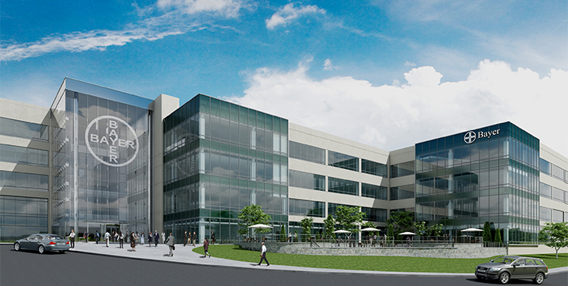
Bayer Summer Internships
Overview
Each summer Bayer hires 5-6 Master/PhD students for summer internships
  Interns work on a clinical trial research project with senior biostatisticians in a fast-paced environment
  They may become involved in analyses of clinical trial data, investigations of novel statistical methods, or comparisons of existing statistical methods. This process may include research, programming, simulations, and providing support to highly knowledgeable clinical trial statisticians and project statisticians
  At the conclusion of the internship, interns present
  their research project to the statistics department
  and also to a non-statistical audience
Bayer offers two 12-week tracks to
accommodate most university schedules
  Mid May – Early August
  Mid June – Early September

Slide 21
Bayer Summer Internships
Requirements
  Motivated and well-organized students pursuing a Master or PhD degree in Statistics, Biostatistics, or a related field who have completed the coursework towards their degree
  Strong analytical and quantitative capabilities along with good written and verbal communication skills
  Good working knowledge of SAS and/or R
  Ability to participate within a multi-disciplinary team as well as acting autonomously as appropriate
  Proficiency in Microsoft Word and PowerPoint
  Must be available for a 12- week assignment from either mid May to early August or mid June to early September
    Previously all interns worked at Bayer’s Whippany, New Jersey site (moving compensation provided), but the last two years Bayer has also offered a residence-based option (at least one week of site visit would still be required to present your project)

Slide 22
Bayer Summer Internships
Benefits
Put your analytical skills to use to help advance clinical trial research
We encourage you to come to the Bayer site in Whippany, New Jersey in order to get firsthand experience about what a career as a statistician in the pharmaceutical industry entails
Improve your resume with statistical experience from a leading pharmaceutical company
Develop networking with colleagues (both clinical trial statisticians, management, and other interns)
Many of our entry level hires have been previous summer interns

Slide 23

Bayer Summer Internships
Application Tips
We typically receive hundreds of applications for just a few positions. The following lists some of the things we look for when selecting candidates:
  Include the relevant coursework you have completed or will have completed by the start of the internship. Mentors typically look for specific analytical skills needed for their project (e.g., Bayesian, Machine Learning, etc.)
  If you are currently working on a thesis or dissertation, give a brief description of the area you are studying
  Include your programming
  proficiency in SAS and/or R
  Include any research or other
  relevant internship/work
  experience you may have and
  include a brief description of
  the associated tasks

Slide 24
Bayer Summer Internships
How to apply
Intern positions for the summer of 2022 have already been filled
Intern positions for the summer of 2023 will be posted around November 2022
For additional information or to answer any questions you may have feel free to contact
    Keith Bangerter (keith.bangerter@bayer.com)
    Frank Cihon (frank.cihon@bayer.com)

Slide 25
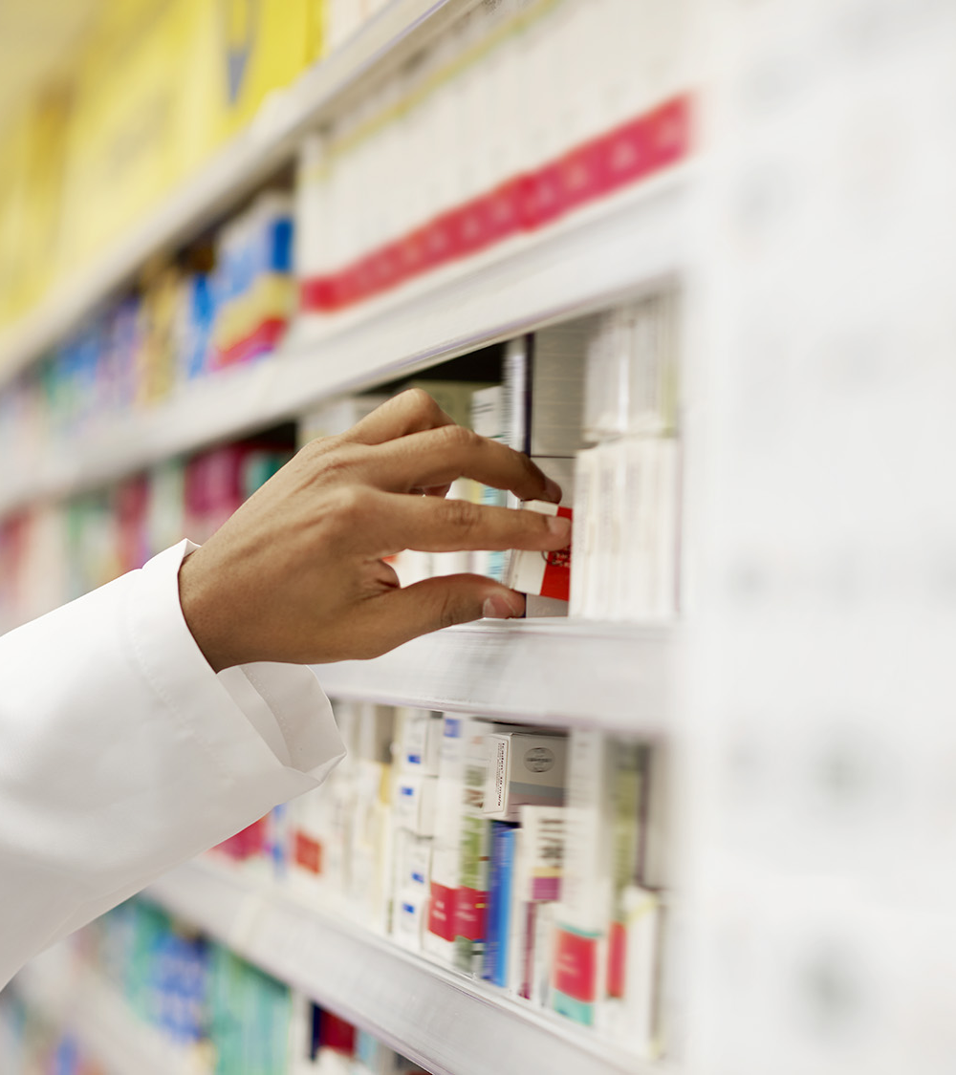
Thank you

Slide 26
Back-up slides

Slide 27
Leadership Practice
    Model the way
    Direct individual involvement and action
    “People first follow the person, then the plan”
    Inspire a shared vision: Leadership is a dialogue, not a monologue
    Inspire people, be able to relate in ways that energize them
    Envision the better future
    Challenge the process
    Incremental steps and small wins
    Enable others to act: Leadership is a team effort
    Foster collaboration and build trust
    Strengthen others

Slide 28
Leadership Practice
Collaboration & Communication
    Within the company
    With external parties (e.g., industry, agencies, academia)
Trust & Empowerment
    Within the team/ company
Innovation & Engagement
    Team motivation
    Taking risks
Growth & Development
    Professional and Personal Growth
    Recognition & Rewards

Slide 29
“The challenge of leadership is to be strong, but not rude; be kind, but not weak; be bold, but not bully; be thoughtful, but not lazy; be humble, but not timid; be proud, but not arrogant; have humor, but without folly.” –JIM ROHN

