Slide 1
Dissertation work in Functional Genomics
Naim Rashid
4th Year PhD, Biostatistics

Slide 2
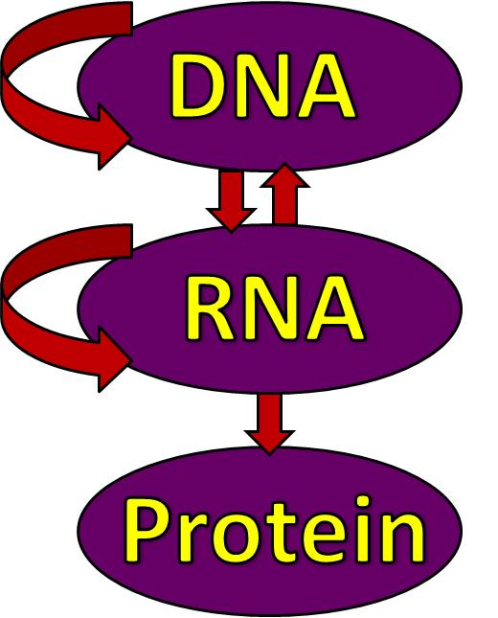
Research in Functional Genomics
How various processes dynamically interact, and in turn, affect gene expression and protein translation
Misregulation/errors provide insight into how diseases develop and how to treat them
The Central Dogma of Molecular Biology

Slide 3
Research in Functional Genomics
DNA Methylation
Copy Number Abberations
Protein-DNA Interaction
Modulation of Open Chromatin
Analysis of Gene Expression
The Central Dogma of Molecular Biology

Slide 4
Research in Functional Genomics
DNA Methylation
Copy Number Abberations
Protein-DNA Interaction
Modulation of Open Chromatin
Analysis of Gene Expression
Measuring this activity genome-wide for a given data type generates an enormous amount of data. Methods for finding interactions between data types and impact on outcomes (gene expression, disease) are also relevant. This is which is where we come in as statisticians
The Central Dogma of Molecular Biology
Notes:
Each of these individually is an avenue of research in itself. However, single genes and prottein binding sites do not operate alone, they are part of a network of regulation over these different functions. Currently we are trying to best determine things within each set, but the next big thing over the next few years wil be how to combine information from multiple types to give us a more complete picture on how the cell interacts with its DNA, and give a more clear picture on what can go wrong to cause disease

Slide 5
Research in Functional Genomics
DNA Methylation
Copy Number Abberations
Protein-DNA Interaction
Modulation of Open Chromatin
Analysis of Gene Expression
The more basic question of how one measures this activity impacts how one develops methods to analyze it. Dependent on what technology is used to measure activity
The Central Dogma of Molecular Biology
Notes:
Each of these individually is an avenue of research in itself. However, single genes and prottein binding sites do not operate alone, they are part of a network of regulation over these different functions. Currently we are trying to best determine things within each set, but the next big thing over the next few years wil be how to combine information from multiple types to give us a more complete picture on how the cell interacts with its DNA, and give a more clear picture on what can go wrong to cause disease

Slide 6
Dissertation Work
First project is dealing with the more basic question of how to best analyze data from a Next Generation Sequencing platform (new)
Microarrays have been the popular platform to assess genomic activity over the last decade
Poised to overtake microarrays in coming years
Build basic analysis framework for this new platform →answer more complicated questions later
Notes:
Microarrays have been the popular platform to assess genomic activity over the last decade, and many methods have been developed to analyze the data generated from it
First project is dealing with the more basic question of how to best analyze data from a Next Generation Sequencing platform (new)
Poised to overtake microarrays in coming years
By building a basic analysis framework for this new platform, we can set the basis to answer more complicated questions using this platform later

Slide 7
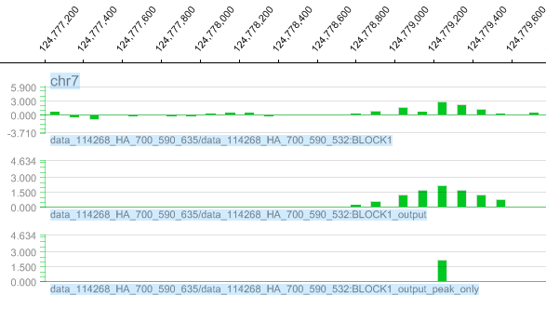
Next Generation Sequencing
Microarray
Notes:
UNC has a dedicated sequencing center through a grant from the state of NC (rare), so many opportunities to do research on this. Goal of either platform are to discovery areas enriched with signal, corresponding to sample of interest. NGS Leads to better resolution, genomic coverage, and dynamic range than microarrays, but has its own technical issues
Generates gigabytes of data on each run, often overwhelming to analyze without specialized methods.
Several methods exist to help detect regions in the genome that are enriched for sample signal

Slide 8
Statistical Issues with NGS
The local genomic percentage of G and C nucleotides has been shown to have an effect on signal, and this effect has been shown to differ between procedure types (above) and even individuals of the same cell type. Several other biases have been identified
Notes:
Recently been shown that background in NGS can be influenced by several factors
These issues can complicate existing methods to determine regions that are truly enriched for signal, leading to false positives
In microarrays, biases were usually adjusted for before analyzing the data.

Slide 9
Statistical Issues with NGS
The way one chooses to represent the raw sequencing data impacts the ability one has to model it. Left is easier to model, but has bad resolution and is subject to boundary effects. Right has excellent resolution, but each point is strongly correlated with adjacent ones, harder to model.

Slide 10
Applied Dissertation Project
How to adjust for multiple biases simultaneously, and incorporate this information into selecting enriched regions?
Which biases to use, how to score them and check if relevant?
What is the best type of data representation to select enriched regions? How to overcome the limitations of each
If these questions can be addressed,
how do you realistically implement
this method for biologists to use?
Notes:
How to adjust for multiple biases simultaneously?
What is the best type of data representation to select significantly enriched regions, knowing that we need to do this adjustment?
How does one overcome the limitations of each kind of representation?
Best biases to use, how to score them?
If these questions can be addressed,
how do you realistically implement
this method for biologists to use?

Slide 11
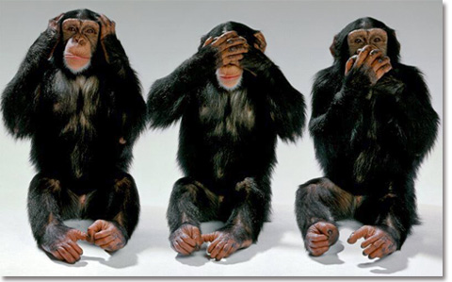
Development of New Method
Collaboration ≠
FAIRE procedure (Lieb lab) is affected more by these biases than others on NGS platforms
Met with lab on a biweekly basis to address these issues.
Had to work closely together to develop the right approach
Communication is key, led to greater relevance of method and extensive testing on real data
Notes:
Biology side: Finding relevant biases to adjust for, how to score them, hypotheses that need to be addressed
Statistical side: Finding best modeling framework that can be applied to adjust for factors, development of statistical algorithm to implement framework

Slide 12
ZINBA
Collaboration resulted in a method called ZINBA (Zero-Inflated Negative Binomial Algorithm)
Mixture of regression models capturing BG (artificial signal) and enriched regions
Regression aspect allows us to estimate effect and relevance of each bias
Model uses window representation to select enriched windows, then calculates overlap representation to get refined boundaries within enriched windows
Notes:
Collaboration resulted in a method called ZINBA (Zero-Inflated Negative Binomial Algorithm)
Uses a regression mixture model to
Assign probabilities of regions being enriched for signal vs. background using an iterative clustering approach
Clustering is guided using biases as covariates in regression models corresponding to enriched and background regions
Regression aspect in addition allows us to estimate effect of each covariate and its relevance to each type of signal.
Uses window representation to run model, collapses significant windows and calculates overlap representation for signal within collapsed window to get refined boundaries

Slide 13
Application to Real Data
Compared to other existing methods, our top calls isolate more relevant regions than others
Our method provides a more appropriate fit to the data

Slide 14
How The Department Made This Work Possible
Genomics training grant allowed me to devote a lot of time to this project
Theory classes
Knowledge of Generalized Linear Model Theory
The Expectation-Maximization Algorithm
Poisson Processes
Learning C led to implementation of C-based translations of R GLM functions, 12x speedup, memory savings
Made Zinba feasible to be used by biologists
Notes:
Grant also provided money to travel to conferences and hear other’s research, buy books, hard drive to store data, etc.

Slide 15
Future project topics
More theoretical paper addressing issues of variable selection in this mixture model context
Comparing multiple samples, look for differential enrichment across samples.
Develop longitudinal framework to detect changes in enrichment over several time points
Tie together multiple data types to look for patterns related to disease states or gene expression.

Slide 16
Questions?
Feel free to email me at naim@unc.edu, or catch me later today

