Slide 1
UNC Biostatistics
Michael R. Kosorok, Ph.D.
Department of Biostatistics
The University of North Carolina at Chapel Hill

Slide 2
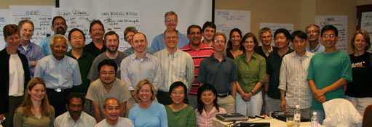
Welcome!
Introductions of prospective students
Introductions of faculty and current students
Department of Biostatistics University of North Carolina at Chapel Hill

Slide 3
Who are we?
146 students
47 faculty members (including joint appointments with genetics, statistics and operations research, psychiatry, medicine, and dental and nursing schools)
Hundreds of staff members (helping faculty; working on large-scale clinical trials and cohort studies; helping students navigate the program!)
Department of Biostatistics University of North Carolina at Chapel Hill

Slide 4
What is our mission?
Bring about positive, sustainable changes in health by
Supporting excellence in biostatistical practice by conducting theory and methods research of relevance and utility to practice
Promoting sound application of new and existing statistical methods
Improving education at the undergraduate and graduate levels
Using tools of our discipline to enhance human welfare through collaboration
Department of Biostatistics University of North Carolina at Chapel Hill

Slide 5
Department Strengths
Strong curriculum that places equal emphasis on methods, theory and applications
Students pursue broad range of research topics, with dissertations falling all across the range of applications to methodology to theory
Students leave UNC well-prepared for careers in academia, government, industry, and other research institutions, with a broad experience in collaborative statistics
Department of Biostatistics University of North Carolina at Chapel Hill

Slide 6
Department Strengths
Strong alumni network
Students graduate and join the 2000+ strong alumni network of leaders in the field
Over 250 joined us this fall for a 60th anniversary!
Great connections for jobs in academia, pharmaceutical industry, government, contract research organizations, ….
Department of Biostatistics University of North Carolina at Chapel Hill

Slide 7
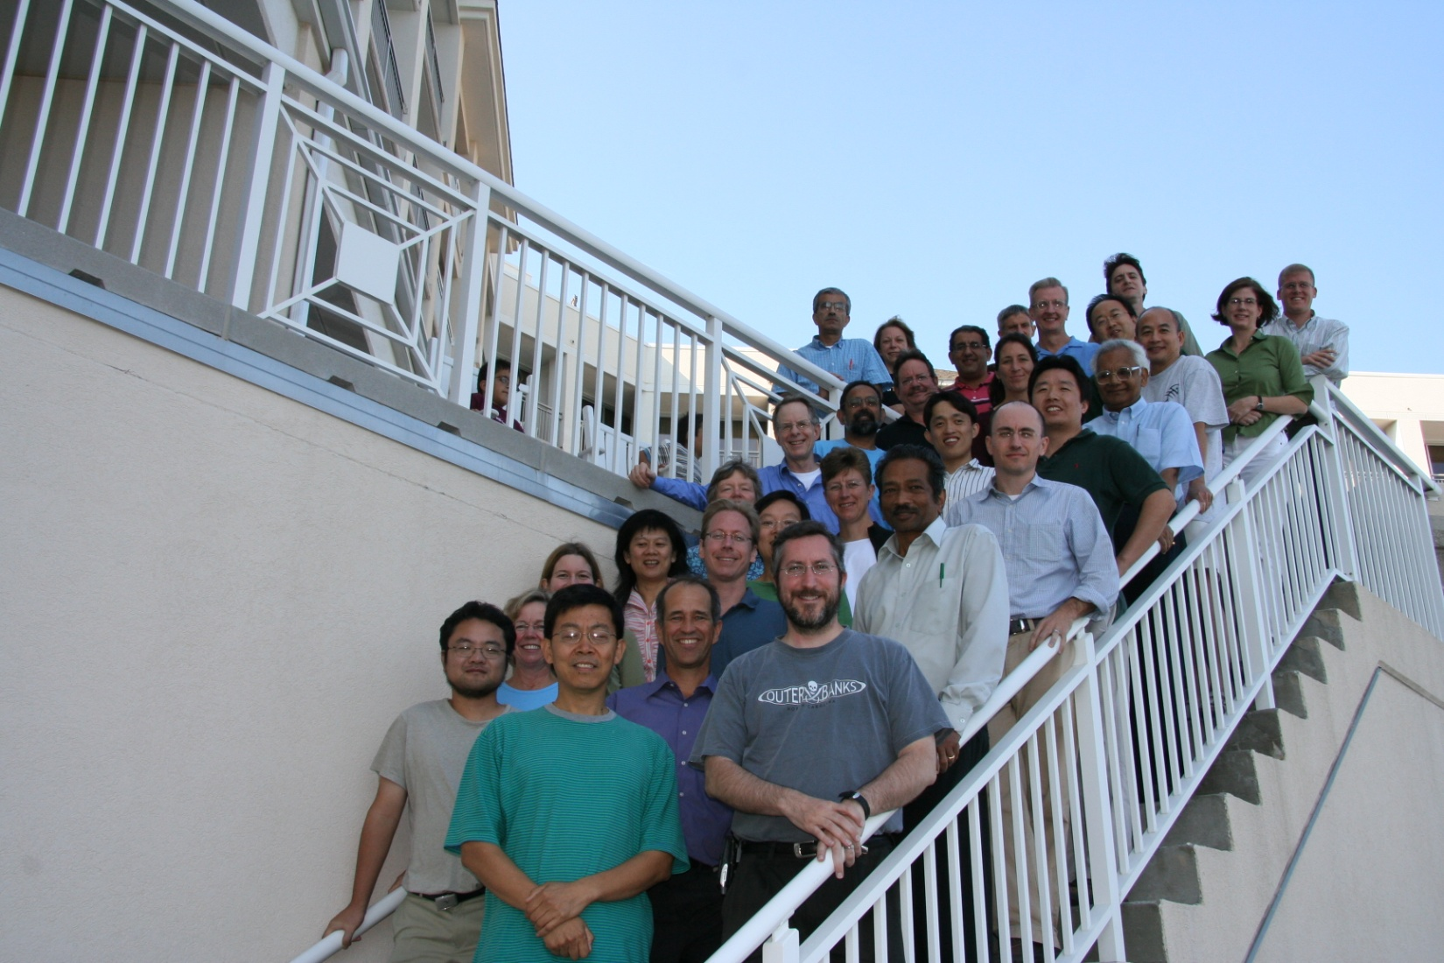
Department Strengths
Outstanding faculty!
Department of Biostatistics University of North Carolina at Chapel Hill

Slide 8
Department Strengths
Outstanding faculty members who are thought leaders in the field and who are dedicated to mentoring students and who win teaching awards!
Over 20 faculty members currently on National Institutes of Health study sections (help decide which new research directions are most promising)
Editors and Associate Editors of many top journals in our field
Many honorary fellows of the American Statistical Association
President-Elect and Regional Committee Members of ENAR, the main professional organization of biostatisticians in the U.S.
Department of Biostatistics University of North Carolina at Chapel Hill

Slide 9
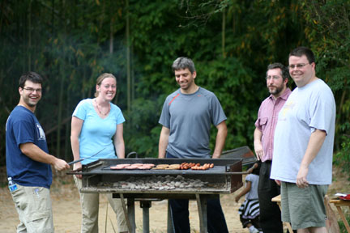
Department Strengths
YOU!
Students of the highest academic and professional caliber!
Department of Biostatistics University of North Carolina at Chapel Hill

Slide 10
Department Strengths
Wide range of research opportunities in the department
Individual collaborations with faculty members in biostatistics, often joint with other faculty members in public health and medicine, in areas ranging from genomics to cancer to environment to infectious disease to child health and clinical trials….
Collaborative Studies Coordinating Center
Biometric Consulting Laboratory
Survey Research Unit
Much more!
Department of Biostatistics University of North Carolina at Chapel Hill

Slide 11
Department Strengths
Chapel Hill!
Fun place to live
College town but nestled among larger cities (many nearby universities almost as good as UNC!)
Great music and restaurants
(Usually!) outstanding sports
Reasonable cost of living
Wonderful weather
Department of Biostatistics University of North Carolina at Chapel Hill

Slide 12
Incoming Class of 2009
Your photo here for 2010!?!
Department of Biostatistics University of North Carolina at Chapel Hill

