Slide 1
Faculty’s Role in Promoting Academic Integrity
Gillings School of Global Public Health

Slide 2
Road Map
Student Conduct’s Purpose
Reporting Process
Life Cycle of a Case
Possible Hearing Options
Possible Outcomes
Source: UNC Chapel Hill Multimedia Library

Slide 3
Student Conduct’s Purpose
1

Slide 4
The “Carolina Way”
Student Conduct’s Purpose
“Student Conduct works to support the development of Carolina students into ethical, responsible future leaders and citizens, encouraging students to make conduct choices that are supportive of students' thriving while at Carolina and beyond.”
Notes:
Our office is comprised of 4 full time staff members with a background in law, higher education, student development, and behavioral health. We advise the student lead Honor System that are responsible for upholding the Instrument often referred to as the Honor Code. Our centralized office was created to promote continuity and equity in academic integrity. Our policies are dense and legalese as they were written by lawyers. As Student Conduct practitioners’ it’s our responsibility to make these policies more consumable for our stakeholders.

Slide 5
Due Process
Student Conduct’s Purpose
Ensuring students’ rights and are upheld
These rights originate from federal and state laws, regulations, and UNC System polices
What could happen if we don’t follow our policies?
Information and informed choices
Presumption of innocence
Counsel
Fair hearing
Self-incrimination
Evidence and witnesses
Proof that is clear and convincing
Appeals and re-hearings

Slide 6
Maintain Disciplinary Records
Student Conduct’s Purpose
FERPA
Recidivism
10 years
Source: UNC Chapel Hill Multimedia Library

Slide 7
Education & Accountability
Student Conduct’s Purpose
“Each of us is more than the worst thing we’ve ever done.” – Bryan Stevenson, Just Mercy: A Story of Justice and Redemption

Slide 8
Reporting Process
2

Slide 9
Expectations for Reporting Academic Dishonesty
Reporting Process
“In the event of student misconduct that appears to violate the requirements of the Honor Code, faculty members, teaching assistants, and other instructional personnel shall:
Report to the appropriate Student Attorney General any instance in which the instructor has reasonable basis to conclude that a student under the faculty member’s supervision has engaged in academic dishonesty…
In the instructor’s discretion, notify the student of the instructor’s intention to report the suspected academic dishonesty and permit the student to provide relevant further information if the student chooses to do so.
Refrain from taking unilateral punitive action as to a student rather than reporting conduct in suspected violation of the Honor Code.
Cooperate with representatives of the student judicial system (including the appropriate Student Attorney General, defense counsel, Honor Court personnel, and the Judicial Programs Officer) in conducting necessary investigation, providing testimony or other evidence, recommending appropriate sanctions, or otherwise bringing the matter to prompt conclusion.” (Instrument, Appendix B, III)”

Slide 10
How to Report
Reporting Process
Visit our website
Anyone can report an incident to Student Conduct
Incidents involving academic and non-academic misconduct

Slide 11
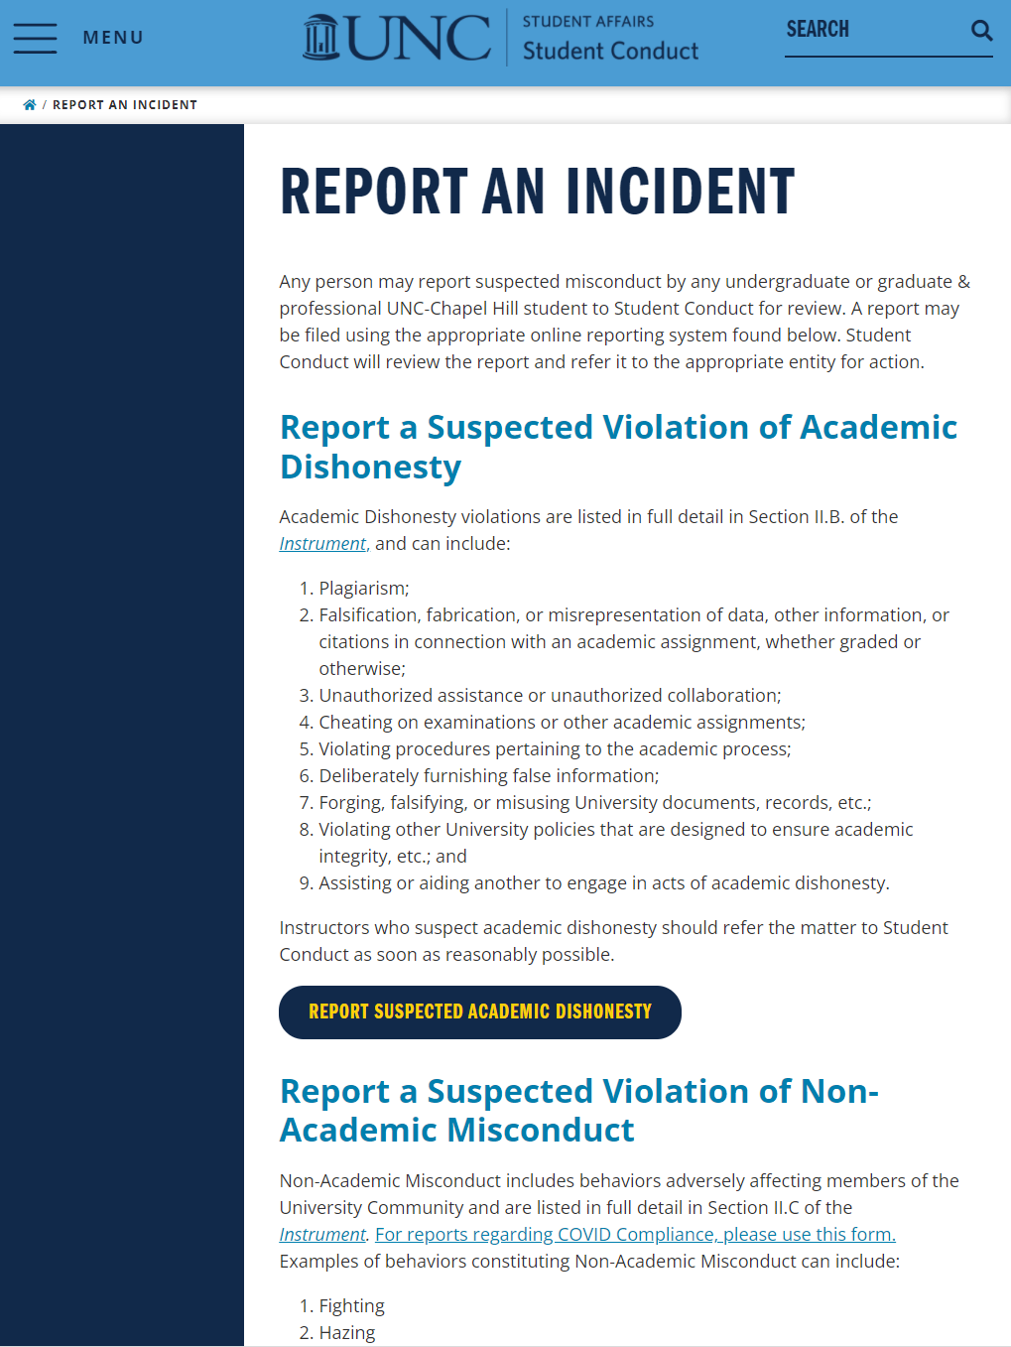
How to Report
Reporting Process
Visit our website
Anyone can report an incident to Student Conduct
Incidents involving academic and non-academic misconduct

Slide 12
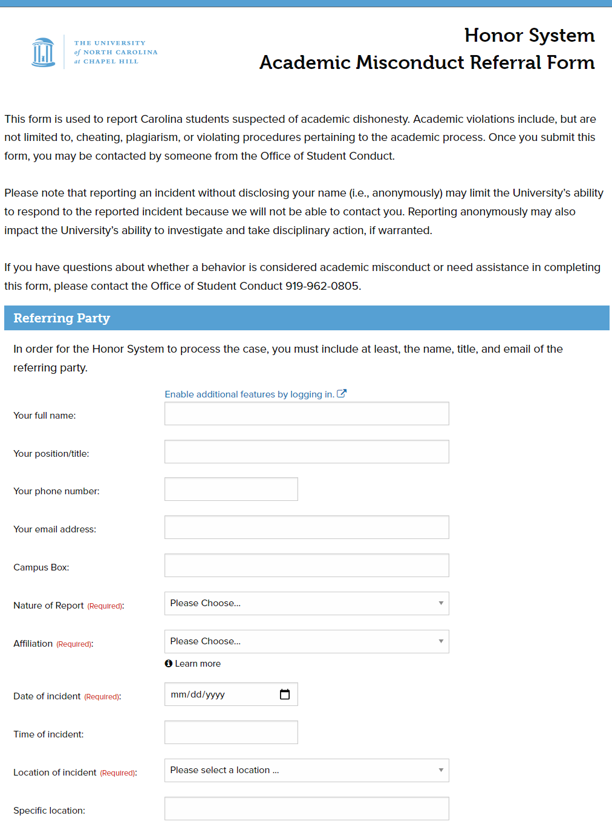
How to Report
Reporting Process
Visit our website
Anyone can report an incident to Student Conduct
Incidents involving academic and non-academic misconduct

Slide 13
Tips for Reporting
Reporting Process
Dos
Identifying information
Include attachments
Who, what, when, where, how
Include objective language
The IR will be included in the file
Inform the student prior to reporting (discretion)
Timely
Continue grading
Don’ts
Vague and ambiguous language
Conduct deep investigations
Feelings and emotions
Interrupt the assignment
Violate FERPA
Make promises

Slide 14
Life Cycle of a Case
3

Slide 16
Life Cycle of a Case
Concern Reported
Referral & Charge Decision
Hearing Preparation
Hearing
Post Hearing Meeting
Appeals

Slide 17
Possible Hearing Options
4

Slide 18
Hearing Options
When a student is accepting responsibility and agrees to the facts of the case:
Expedited Hearing Process
Honor Court Alternative Resolution
Student-Instructor Alternative Resolution
When a student is not accepting responsibility
Not Guilty Hearing
When a student accepts responsibility but disagrees on the facts of the case:
Full Guilty Hearing

Slide 19
Hearing Types Data

Slide 20
Possible Outcomes
5

Slide 21
Outcomes
No charge
Drop charge
Found not responsible
Found responsible & assigned sanction(s)
Appeals: Dismissed, remanded, revised, upheld

Slide 22
Sanctioning Philosophy
Possible outcomes
Education & Accountability
Balancing the needs of the University and the student

Slide 23
Deciding Academic Sanctions
Education and Accountability
Every case with a finding of responsibility will receive:
1. Grade sanctions
Failing grade on the assignment, component or aspect of the course, or course
2. Penalty of records
Written warning, disciplinary probation, suspension, or expulsion
Optional: educational assignments
Category of the offense
Minimal, moderate, major
Four relevant factors
Gravity of the offense
Value of learning
Equitable treatment
Compelling circumstances

